Slide 1
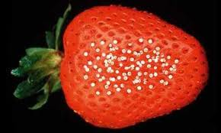
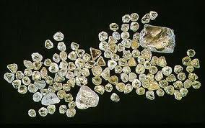
Diamonds
From Botswana to Boutiques

Slide 2
Chapter 2 Creative Writing: Obed Ramotswe
In journal form, using rich sensory details, please describe Obed’s experience working in the diamond mines of South Africa. You can write in 1st person (as if you were Obed looking back on his life) or the more challenging 3rd person omniscient (where you know thoughts and feeling of the characters). With the use of the novel, include 3 specific details from the text.
Avoid weak words (a lot, very, good, so, thing, stuff, said, bad…)

Slide 3
What is a diamond’s allure?
Symbolizes: Romance, Strength, Beauty, Wisdom
“It’s the closest you’ll ever come to a star” (Parisian Diamond Exhibit Attendee)
“Diamonds are Forever”- Debeers

Slide 4
Bling Bling…
3 Billion Years old
Unchanged since their formation
Cold to the touch- Draws in heat
So dense they slow the speed of light by 2/3rds
Can only be scratched by another diamond.
Surfaced through eruption- Kimberlite- and helpful termites
“Diamonds are a Girl’s Best Friend”- Debeers

Slide 5
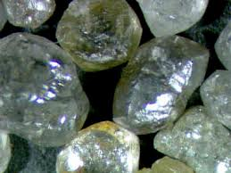
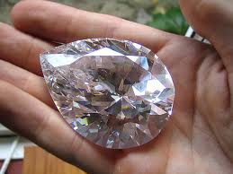
Facts
120 Million Carats of rough diamonds extracted globally each year
Total: 24 tons= 1 truck load = $50 billion
1 carat= 1/5 of a gram

Slide 6
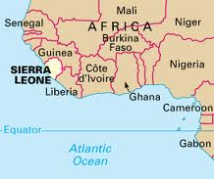
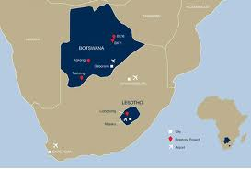
History
South Africa- 1867
Botswana- 1967
1 Billion dollars a year from 1 mine
Fringed on the Kalahari
Enabled Botswana’s high standard of living in Africa

Slide 7
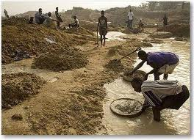
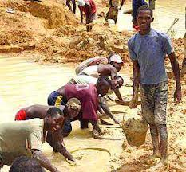
Reality for Botswana’s Miners
"I'm a soldier for my country," Kgomokhumo says. For him, as well as many others in this small, arid country, diamonds are a source of both income and pride.

Slide 8
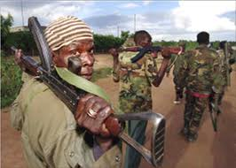
Underground…
What is a Blood Diamond?
Rebels control diamond rich mines
Civil war funded through diamonds
Slave labor
War torn areas of DRC
Debeers???

Slide 9
War Torn Villages of Sierra Leone
Militia used terror tactics to control villagers and maintain power
Innocent people and children purposely harmed
Diamonds smuggled out of the country
The world became aware:
“That dazzling diamond necklace you buy for that special someone at a swank Fifth Avenue jewelry store may be funding the activities of a cannibal gang in Sierra Leone”. – New York Post- 1999

Slide 10
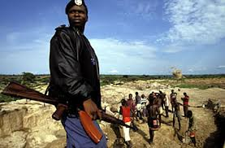
Human Nature
The simple fact of human nature”, explained Gould, the mine manager, “is that if people get a hold of diamonds, they will keep them”
Not allowed to touch the ground
Security Zones/Cameras
Daily searches and x-rays
”

Slide 11
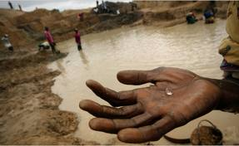
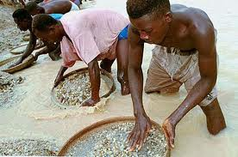
Mining Conditions
Less then $1 a day
Extreme poverty
No access to clean water or medical
Child Labor
Asbestos and toxins
Lung Infections
No Worker Rights
Work to Work- Pay outs

Slide 12
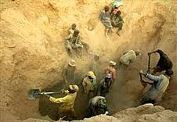
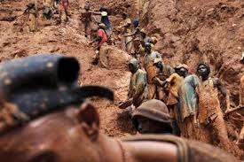
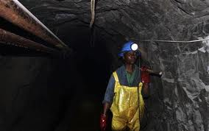
Health and Safety
Backbreaking and dangerous labor; with weeks or months without reward

Slide 13
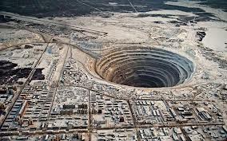
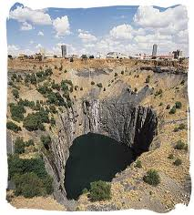
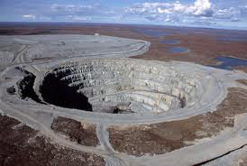
Water, Ocean, Land Issues: Abandoned mines and lives covered by sand

Slide 14
“If there is a boycott of diamonds the economies of Botswana and Namibia will collapse”- Nelson Mandela

Slide 15
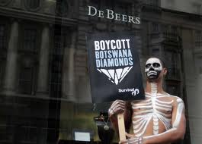
Debeers

Slide 16
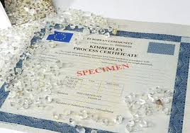
The Industry Listened: Let’s face it, they had to …
Debeers agreed that diamonds had to come from their own mines
Stringent certifications marking all diamonds as “clean”.
Imposter diamonds rise up? C.Z.

Slide 17
“Diamonds are Forever” Clip JourneyManTV
https://www.youtube.com/watch?v=eA54l8q6JhQ
Sierra Leone: https://www.youtube.com/watch?v=2TT3NfoeDrc

Slide 18
Two Voice Poem
With a partner or solo
At least 3 stanzas per voice
15 lines on each side
Ensure a title

Slide 19
HW
Read Chapters 3 and 4

