Slide 1
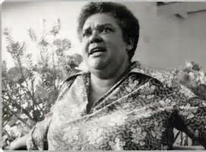
Voice of Botswana
Bessie Head

Slide 2
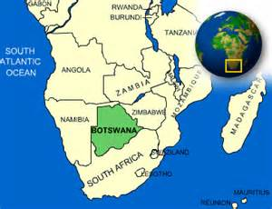
Botswana: Bechuanaland Protectorate

Slide 3
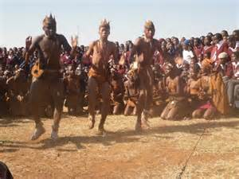
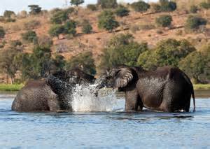
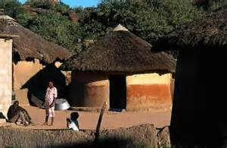
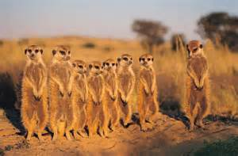
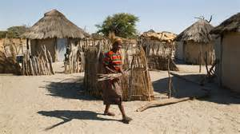
Yes Botswana is this…

Slide 4
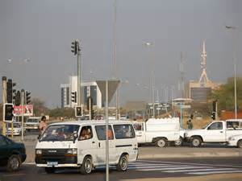
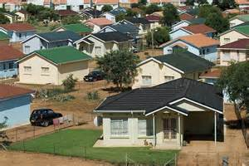
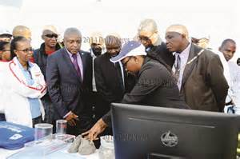
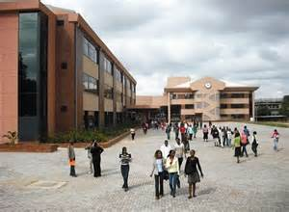
Botswana is also this…

Slide 5
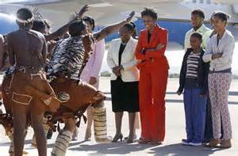
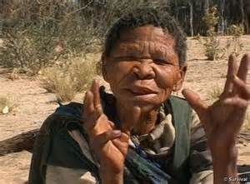
Botswana has many voices and perspectives!

Slide 6
GOALS
To understand our own perspectives, stereotypes, and bias
To become aware of the writers of different cultures; to be exposed to both their traditional and contemporary ways of living.
To see how literature and the arts mirror historical and social change.

Slide 7
The Author: Bessie Head
Born in South Africa, the child of a wealthy white South African woman and a black South African servant when interracial relationships were illegal in South Africa.
In 1964, abandoning her life in South Africa, she moved with her young son to Botswana seeking asylum- Was a refugee for 15 years!
Politically Motivated - PAC

Slide 8
Bessie Head

Slide 9
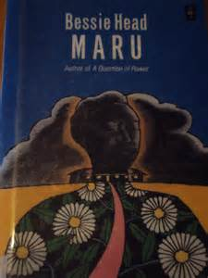
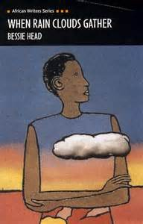
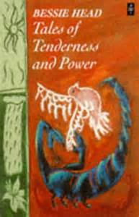
Novels, Short Stories, and Essays

Slide 10
Her Most Famous Novel
In When Rain Clouds Gather , the author explores the consequences of being stuck in tradition and resisting change and oppression. But in the end the story shows that sometimes, mankind can only persevere through so much, and that circumstances might force people to take action, albeit non-violently. For it is known that “Violence breeds hatred and hatred breeds violence. Hatred can only be defeated by love and peace.”

Slide 11
“Bessie Head’s writings cover many aspects of her personal experiences as a racially mixed person, growing up without a family in South Africa. Her works deal with issues of discrimination, refugees, racialism, African history, poverty, and interpersonal relationships. A hint of autobiography is present in much of Head’s writing, which often deals with poor and emotionally abused black women dealing with both racist and sexist discrimination” (“Bessie Head”).

Slide 12
Awards
In 2003 she was awarded the South African Order of Ikhamanga in Gold for her "exceptional contribution to literature and the struggle for social change, freedom and peace.”

Slide 13
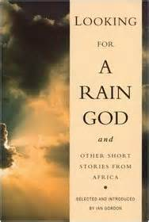
“Looking for a Rain God”

Slide 14
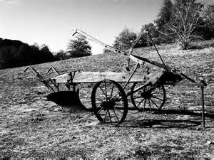
Agrarian Lifestyle

Slide 15
Annotate directly on your story
What details describe setting? What role does the setting have on the people?
Locate socio-cultural practices or beliefs.
What symbols emerge in this story? Locate and note their possible meaning?
What do the children symbolize? What’s unique about their dialogue?
What irony is present?

Slide 16
Figurative Language
Hyperbole
Personification
Simile
Metaphor
Imagery /Sensory imagery
Thermal imagery
Alliteration
Sibilance
Idiom

Slide 17
Figurative Language
“catch the rain in a cup it would only fill a teaspoon”
“earth was alive with insects singing”
“the sun danced dizzily in the sky”
“the rain fled away”
“the sky bare”
“the sun sucked up the last drop of moisture out of the earth”
“hung like a dark cloud of sorrow”
“deathly silence at night”
“devouring heat of the sun by day”

Slide 18
What is this story about? What did you notice about the writing?

Slide 19
What is this story about? What did you notice about the writing?
Implications of the land (harsh realities)
Beautiful images of the landscape
Customs clashing with new ideals
Contrasts of beautiful images with the conclusion

Slide 20
Rain Drops

Slide 21
Example
In Bessie Head’s “Looking for a Rain God”, survival and desperation are portrayed throughout the story of experiencing the long drought. In the story, the drought brought fear as people tried to seek divine intervention to bring the rain. With no crops to sell, the narrator writes, “[o]nly the…witchdoctors made a pile of money during this time because people were always turning to them in desperation…” (57). Clearly the dry landscape and unknown rain leads the characters to seek traditional methods to reap their crop and livelihood, revealing their struggles and states of destitute .

Slide 22
Works Cited
https://scholarblogs.emory.edu/postcolonialstudies/2014/06/10/head-bessie/

