Slide 1
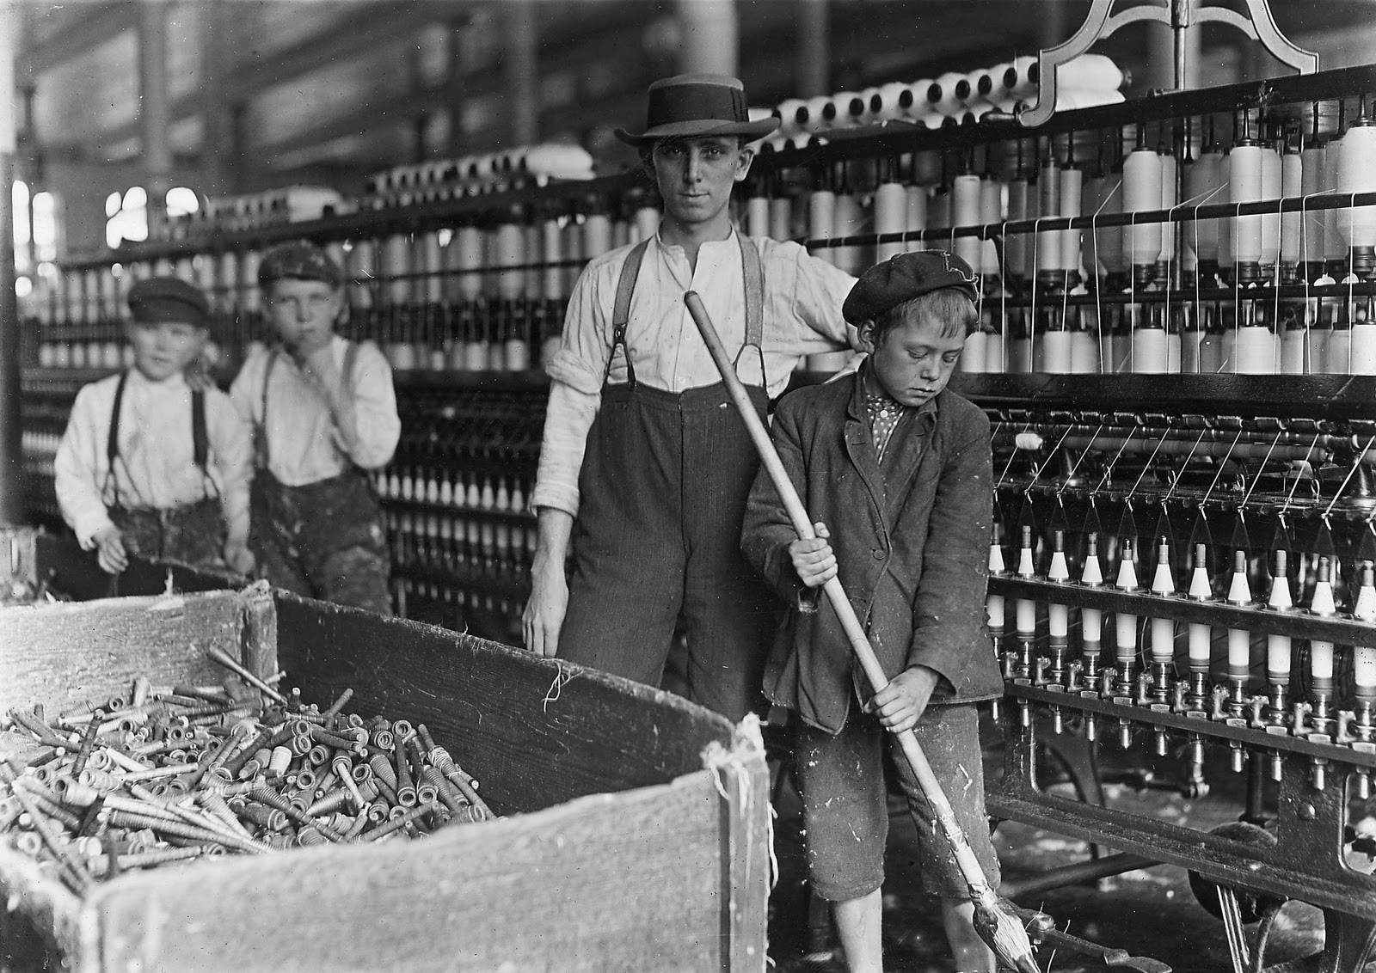
The Rise of Industrial America

Slide 2
Industrial Revolution 1820-1870

Slide 3
Post Civil War Industrial Boom 1876-1900

Slide 9
What is hard work?

Slide 14
Small Rooms- High Rent

Slide 15
Apartments

Slide 16
Angel Island

Slide 17
Medical Exams

Slide 18
Point of Entry

Slide 19
Awaiting Interrogations

Slide 20
Voices in the Walls

Slide 21
Barracks

Slide 22
Earthquake of 1906

Slide 24
San Francisco after 1906

Slide 27
Jack London
Socialist, involved in the labor movement
Became a writer because afraid of falling into the underclass.
Tried to reconcile his own connections to working-class and middle class identities

Slide 28
Themes raised in “South of the Slot” ?
Duality of human existence
Free will vs. social influences (“naturalism”)
Class divisions
Civilized vs. “Uncivilized”
Educated class vs. Working class

Slide 29
Activity
With your group (3-4 people), create an outline/shape of a body.
Using quotations from the text (at least 3 on each side), represent the duality experienced by the main character.
Think about how you, as individuals, experience duality (inner conflict between opposing forces).
Include symbols and images as well)
(Make ‘em pretty)

