Slide 1
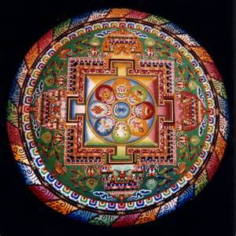
Sacred Symbols and Eternal Archetypes

Slide 2
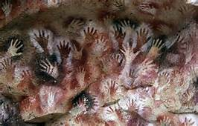
Cueva de las Manos, Argentina 13,000-9,000 Years old

Slide 3
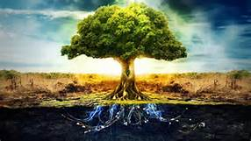
The two most common symbols
The Circle/The Mandala- Symbolic of eternity, rebirth, continuity
The Cosmic Tree- symbol of self; linking to earth and sky

Slide 4
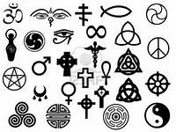
Other Sacred Symbols
Dot
Egg/Seeds
Square
Triangle
Spiral
Wheel
Swerve/Snake

Slide 5
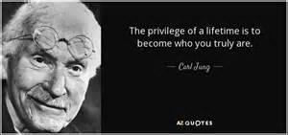
Carl Jung 1875-1961

Slide 6
Archetypes and the Human Condition
We recognize that the “universal symbols common to many world religions are archetypal products of humankind’s “natural religious function” as described by Carl Jung.
Jung thought: Inherent in the individual human psyche is an ancient collective memory, in which humankind’s universal experience is symbolized by means of archetype (Gibson 13).

Slide 7
Joseph Campbell
“It has always been known [that] the prime function of mythology and rite, [is to] supply the symbols that move the human spirit forward.”

Slide 8
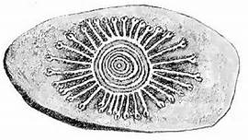
Aboriginal Symbols
Two Categories
Those related to “The Dreaming”: wondijna (first beings, according to Aboriginal Australians)
Those associated with the totemic ancestors: kangaroo, digging sticks, tjurnga

Slide 9
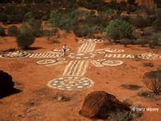
Sacred Lands

Slide 10
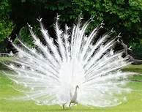
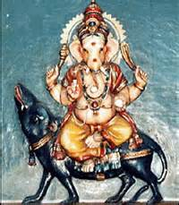
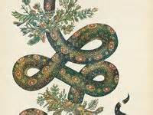
Sacred Animals- World Wide
-

Slide 11
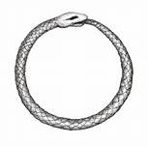
Ouroboros

Slide 12
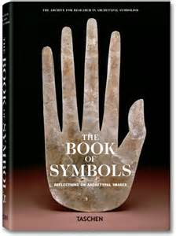
Understanding Symbols and Archetypes helps us to deeper connect with literature. Remember, Literature allows us to connect to the Human Condition

