Slide 1
HAPPY HAWTHORNE Thursday!
REMINDER: IB forms are soooooo over due.
Please have out your Hawthorne Packet and Scavenger Hunt from last class
Turn in Story Boards if need be

Slide 2
Literature and Art
NOTES Continued

Slide 3
Romanticism- 1700s
Imagination and emotion are more important than reason and formal rules
Romantic literature tends to emphasize a love of nature, a respect for primitivism, and a valuing of the common, "natural" man.
Romantics idealize country life and believe that many of the ills of society are a result of urbanization.
Powerful love; unreturned love; rival suitors; lovers parted; father disapproval

Slide 4
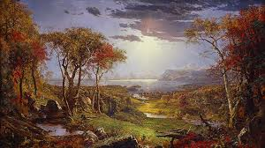
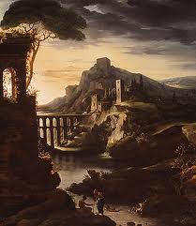
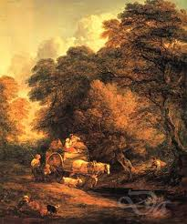

Slide 5
From Romantic to Gothic Literature: 1764-1890s
combines horror and romance
ruined buildings/castles ; sinister or melancholy,
shadows, a beam of moonlight in the blackness, a flickering candle, or the only source of light failing; chiaroscuro
extreme landscapes and weather, like rugged mountains, thick forests, or ice
magic, supernatural manifestations
a passion-driven, willful villain-hero or villain
a curious heroine with a tendency to faint and a need to be rescued
a hero whose true identity is revealed by the end of the novel,
horrifying (or terrifying) events or the threat of such happenings.

Slide 6
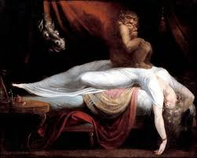
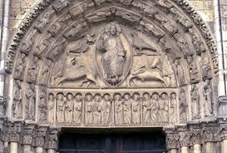
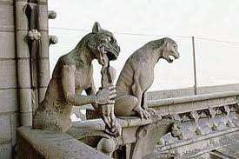

Slide 7
“The Birthmark Questions” (annotate answers in your packet)
1. How is the birthmark on Georgiana “…the symbol of his wife’s liability to sin…(302)”, for Aylmer?
2. Where do we see proof of the Puritan element in this story? Where do we see proof of the Gothic element? (review Gothic notes if needed)
3. What is the moral of the story? Where do we see it come up (not just in the conclusion, but in the foreshadowing seen throughout as well).

Slide 8
1 Minute List

Slide 9
What do you see?

Slide 10
Chiaroscuro
The juxtaposition/ arrangement/treatment of light and dark in a pictorial work of art, translates from Italian as light/clear + dark/obscure

Slide 11
Duality continued…
How does Rembrandt use light and darkness to draw attention to certain people/objects in the painting.
Why?

Slide 12
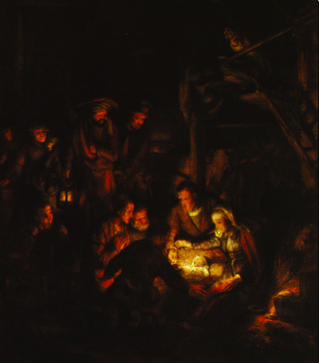

Slide 13
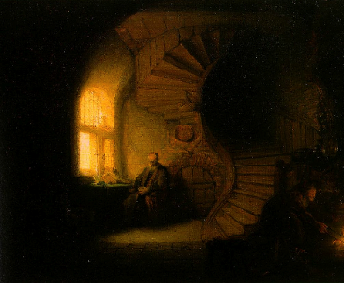
“Philosopher in Meditation”

Slide 14
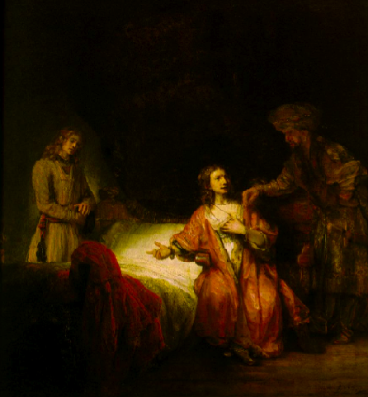
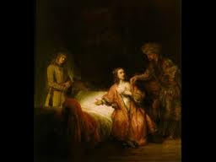
“Joseph Accused by Potiphar’s Wife”

Slide 15
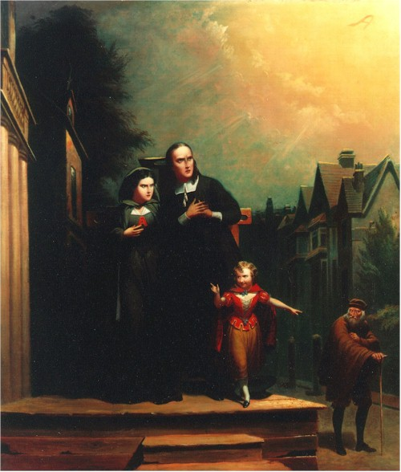
Hawthorne’s Literary Characterization
Hester, in The Scarlet Letter is described as "a black shadow emerging into the sunshine” (Hawthorn 49).
How does Hawthorne “paint” this scene using words?

Slide 16
Tone vs. Mood
Tone is the author’s attitude toward a subject.
Mood is the atmosphere of a piece of writing; mood is the emotions a selection arouses in a reader.
Some common mood descriptors are: desolate, relaxed, nightmarish, dreamy, peaceful, numb, nervous, angry, confident…

Slide 17
HOMEWORK
Read “The Minister’s Black Veil”
Take LOTs of NOTES on the elements of Chiaroscuro and other Gothic style attributes you notice.
Paraphrase throughout
Mark up your story with observations and interpretations
DUE Next Class

