Slide 1
Beloved
By Toni Morrison

Slide 2
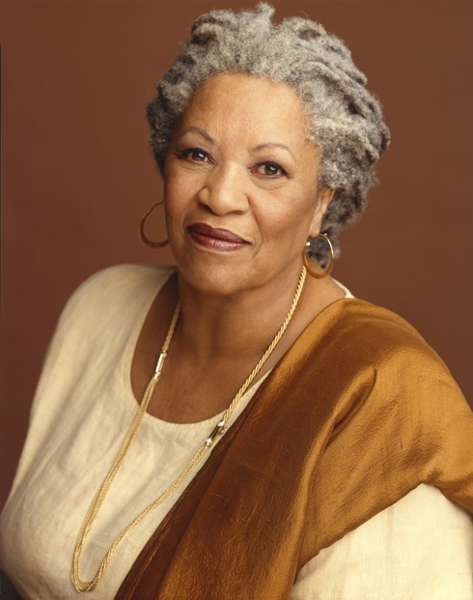
About the Author…
Born in Loraine, OH in 1933; Died August 2019
Earned a B.A. from Howard University in 1953 and an M.A. from Cornell University in 1955
Taught at various universities, including Texas Southern, Howard, NYU, and Princeton

Slide 3
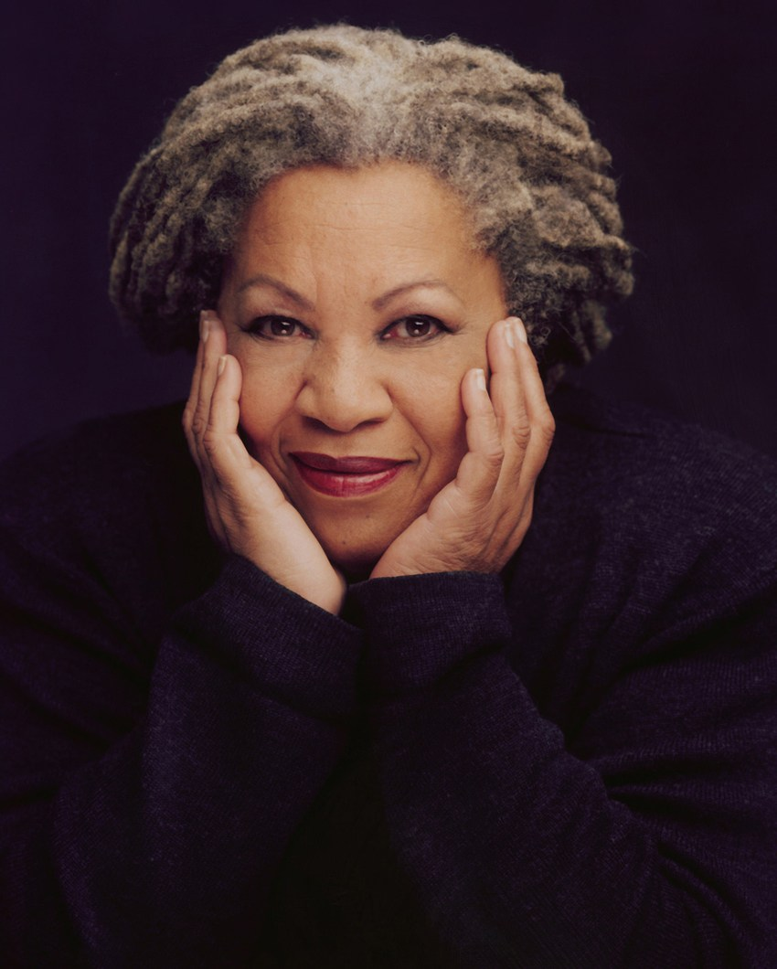
Toni Morrison
Became a fiction writer in 1970 with publication of her first novel, The Bluest Eye
Other notable works include:
Song of Solomon
Sula
Jazz
Home

Slide 4
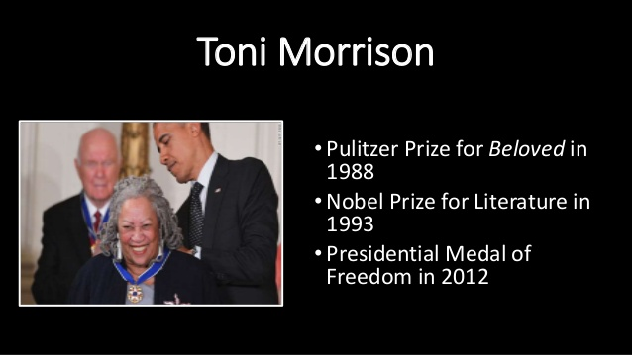
Recognition as a Writer

Slide 5
Morrison as Writer
Known for her honest, often brutal, examination of the Black experience, particularly the Black female experience
Also known for her portrayals of the Black community, both positive and negative
Blends myth, folktale, poetry, and fantasy into your stories– creates an almost surreal quality to everyday people and events

Slide 6
A quick video…
https://www.youtube.

Slide 7
From the introduction to Beloved…
“[Margaret Garner] became a cause celebre in the fight against the Fugitive Slave Laws, which mandated the return of escapees to their owners. Her sanity and lack of repentance caught the attention of abolitionists as well as newspapers. She was certainly single-minded and, judging by her comments, she had the intellect, the ferocity, and the willingness to risk everything for what was to her the necessity of freedom.”

Slide 8
From the introduction to Beloved…
“The historical Margaret Garner is fascinating, but, to a novelist, confining. Too little imaginative space there for my purposes. So I would invent her thoughts, plumb them for a subtext that was historically true in essence, but not strictly factional in order to relate her history to contemporary issues about freedom, responsibility, and women’s ‘place’.”

Slide 9
Beloved…
“The Herculean effort to forget would be threatened by memory desperate to stay alive.”

Slide 10
Sixty million and more…
What is this number a reference to?

Slide 11
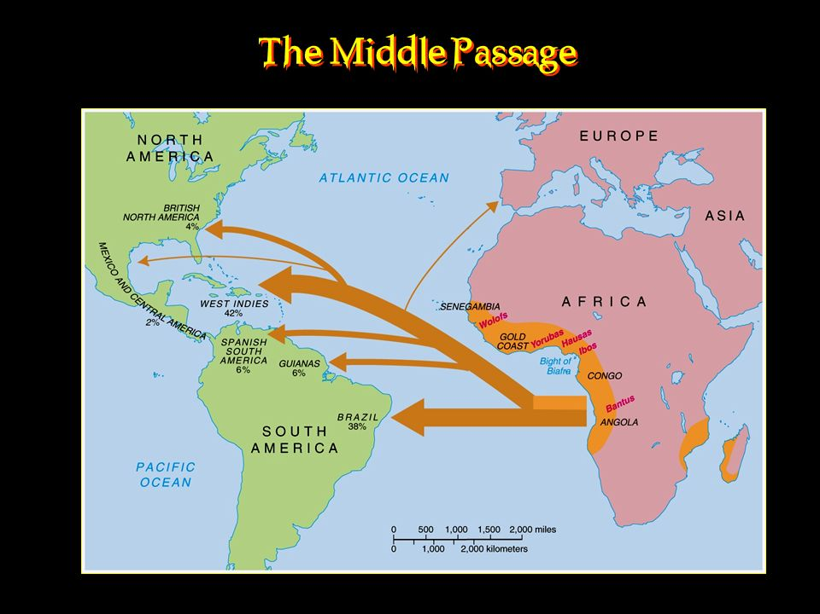
The Middle Passage

Slide 12
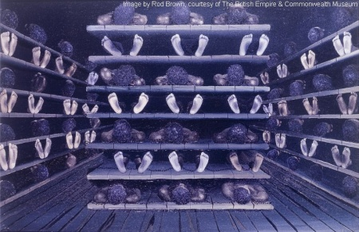
Images of slave ships from Middle Passage

Slide 13
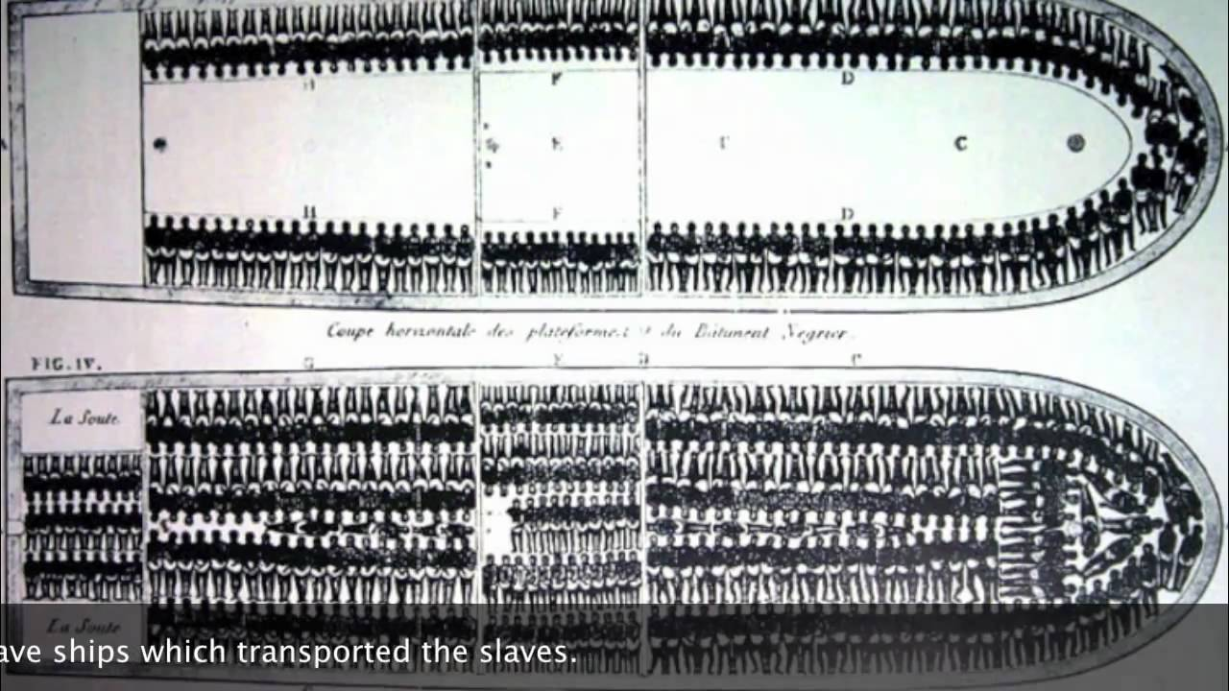
Images of slave ships

Slide 14
Dedication of the novel
Why do you think Morrison chooses to dedicate this novel to the “60 million and more”?

Slide 15
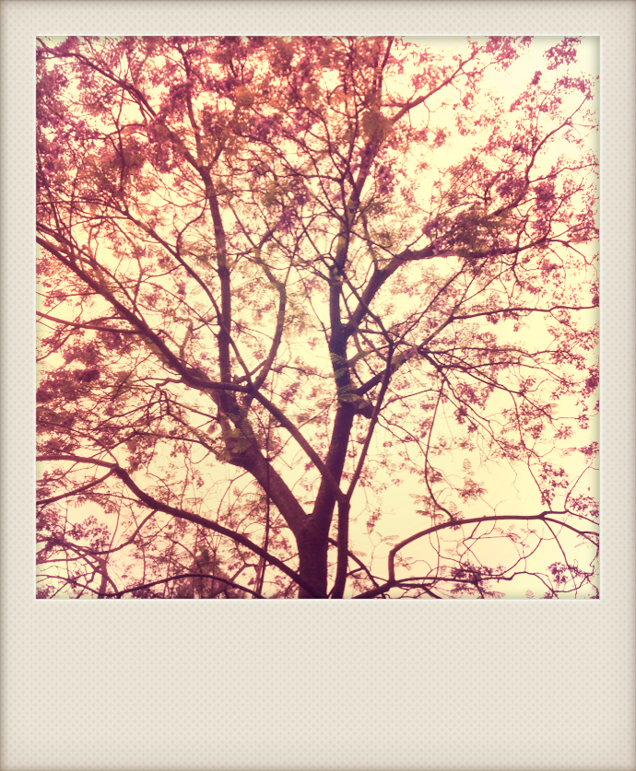
Chokecherry Tree

Slide 16
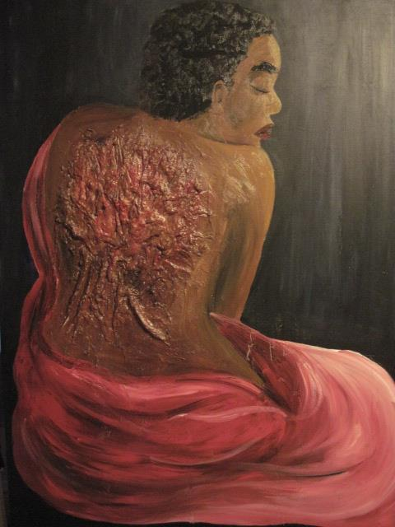
Tree as scars

