Slide 1
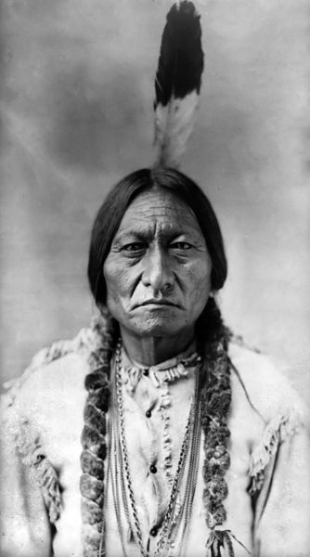
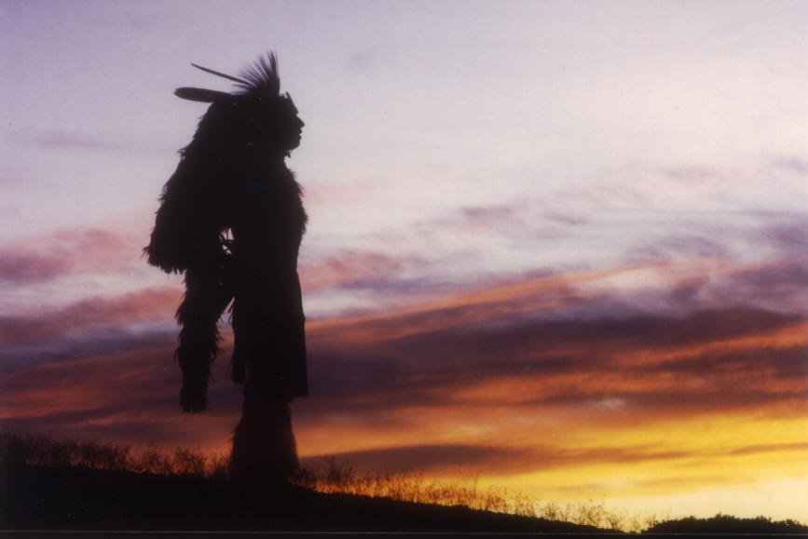
Introduction to Native American Literature
LOTA (2019)

Slide 2
Native American Literature is defined by Cultural Diversity
At the time of Columbus’s arrival to the “New World”, 350 distinct languages existed in North America
Thousands of distinct cultural groups existed as well.
There is NO single Native American culture, language, or literature.
so

Slide 3
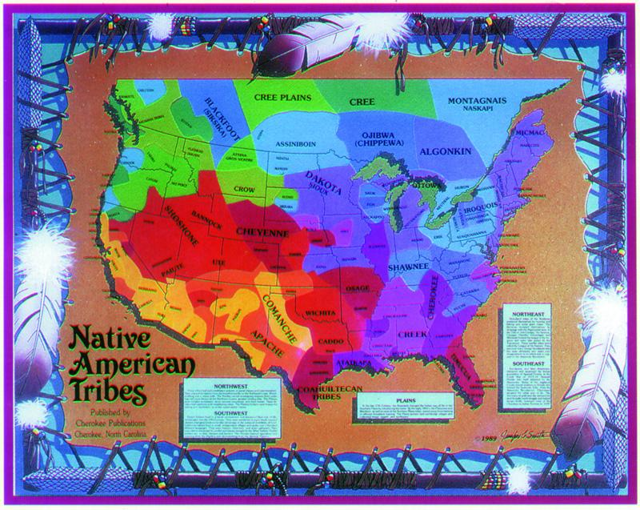
History of Stability
Prospered for thousands of years in a stable relationship with the land
Hundreds of individual tribes with their own cultural traditions (more diverse than Europe at the time)
Joined together—more in common with each other than with European settlers.

Slide 4
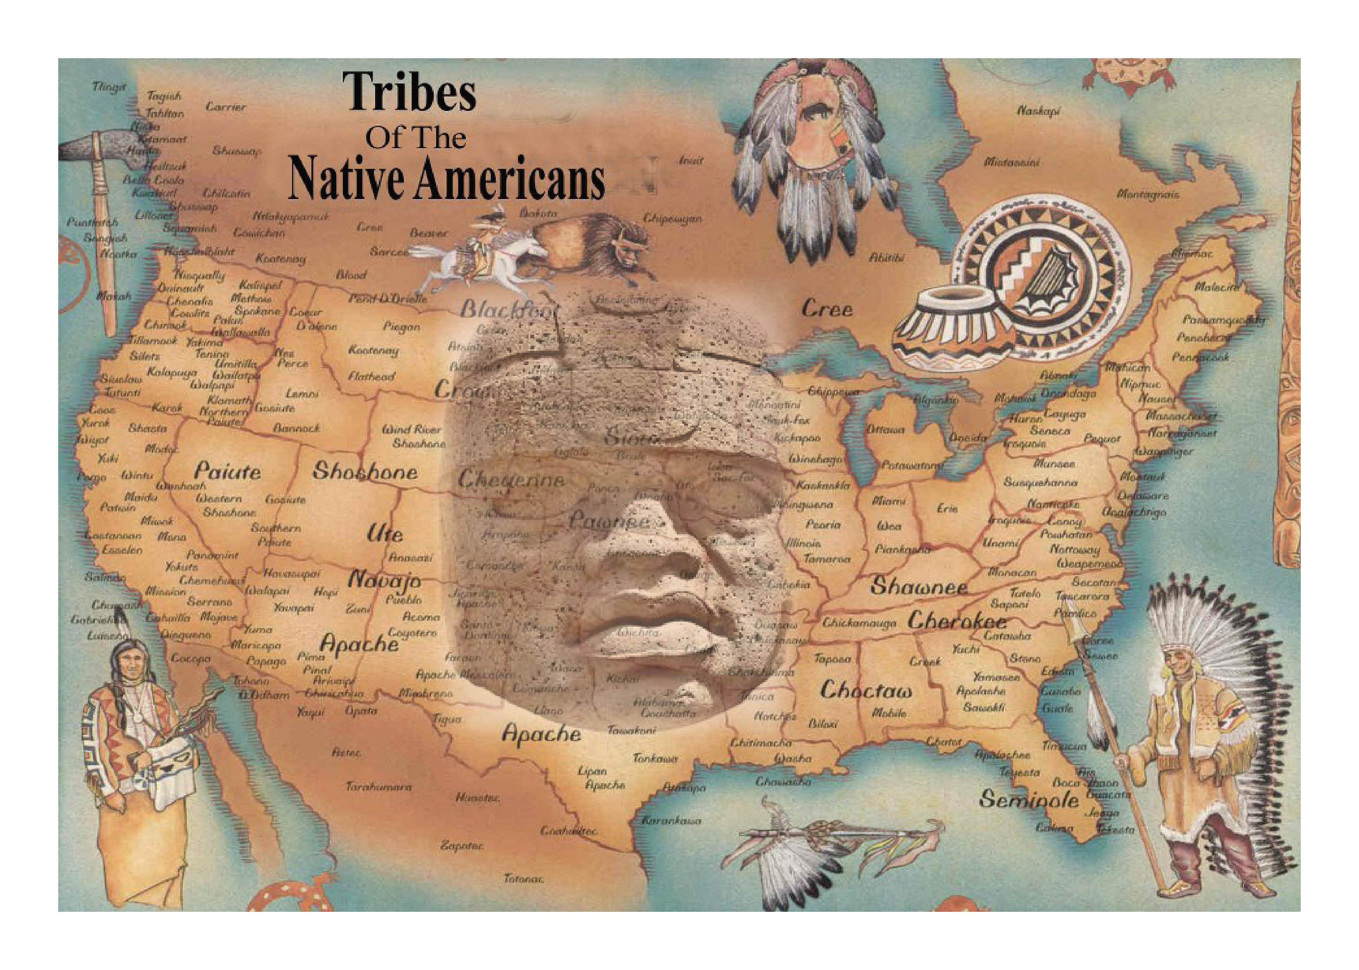

Slide 5
However, the U.S. government created numerous laws to ensure that Native Americans were isolated both geographically and culturally. WHY??
Few opportunities to demonstrate aspects of their culture because of their focus on survival.
So
Geographically: reservations on remote and least productive land

Slide 6
So how did Native American Literature become known to a wider audience?
1856: First widely known written N.A. literature by John Rollin Ridge (Cherokee, encompassed Far West in his writing).
Late 19th century: many anthropologists began to write down stories and languages they heard while examining N.A. culture.

Slide 7
Native American Literature not considered “valid” literature before this time due to western notions of literature.
Early American history:
described by Europeans
judged by European sensibilities
Native American stories and culture not recognized as “good” settlers. If it wasn’t a book, it wasn’t literature.
1960s-70s: Native American literature given a place in American literary canon.

Slide 8
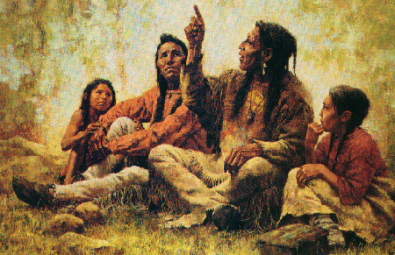
What are the characteristics of Early Native American Literature? (Remember, it is difficult to generalize the diverse cultures.)
Oral history:
Good speakers valued in many tribes because of tradition of participatory democracy
Stories handed down through the oral tradition

Slide 9
Lost in Translation
European invasion brought linguistic tools for written records; however:
No English words for some native terms
Poetry dependent on rhythm and repetition; translation is really new work
Caucasians rarely given full tales and/or translations shaped to fit audiences’ prejudices

Slide 10
Characteristics of Early Native American Literature
Oral Tradition
Storytelling: primary means of communicating and teaching about the physical world, social order, appropriate behavior, human nature, and the problem of good vs. evil.
Repetition is a common characteristic
Ritual beginnings and endings
Use of archaic language
Terse writing style

Slide 11
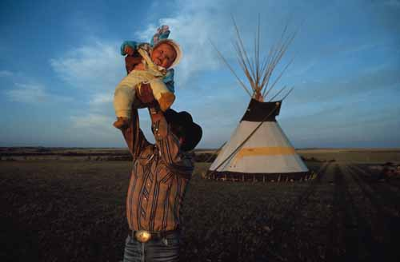
Today
Many contemporary Native American writers work to preserve their heritage, correct misunderstandings, and represent common native struggles.
Modern Native American writers work hard to blend the past with pressing current issues and modern lives of Native people today.

Slide 12
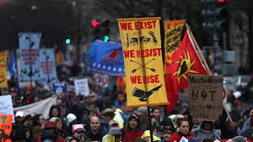

Slide 13
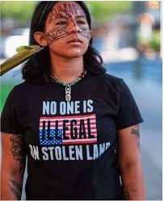
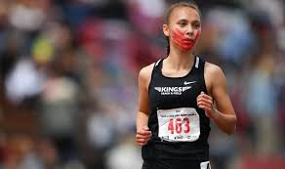
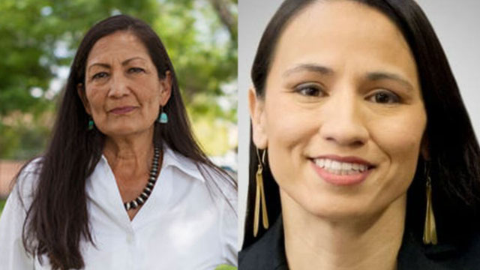
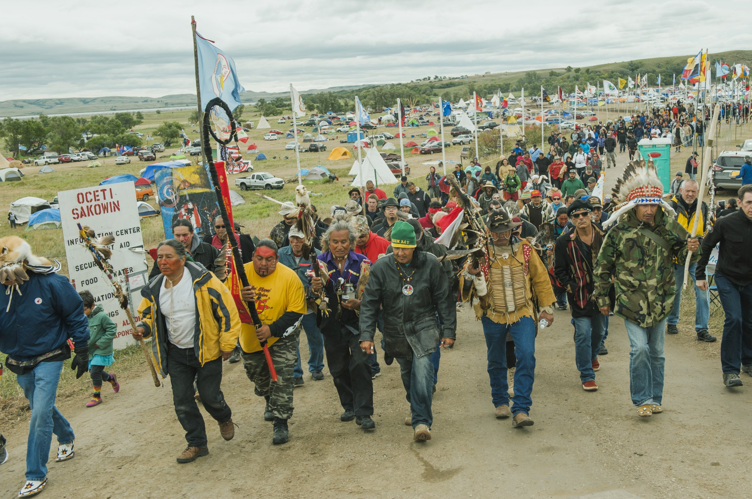
High school track star Rosalie Fish wore a red hand print across her face and the letters MMIW (Missing and Murdered Indigenous Women) as she competed last year
Native American protesters fighting against restrictions on immigration and the Dakota Access Pipeline.
Deb Haaland (New Mexico) and Sharice Davids (Kansas), first Native women elected to Congress in 2018

Slide 14




A Few Contemporary Native American Authors
Louise Erdrich: well-known Native American author from Minnesota; has Native American bookstore
Sherman Alexie: much of his writing stems from his experience as a Native American
Paula Gunn Allen is a contemporary Native American author who also writes through a Feminist lens.
N.Scott Momaday: contemporary Native American author; The House Made of Dawn is an American classic.

Slide 15
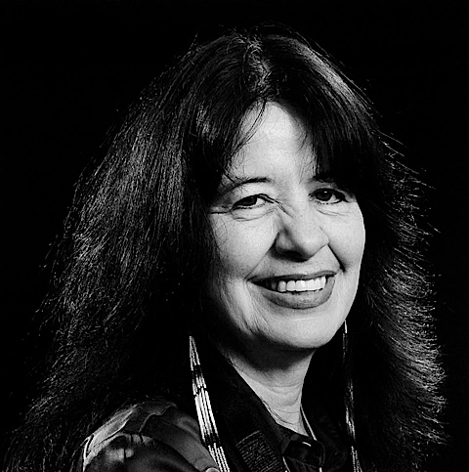
Joy Harjo—U.S. Poet Laureate for 2019
Born in Tulsa, Oklahoma
Member of the Muskogee tribe
First Native American Poet Laureate EVER!
Writer, poet, musician, educator, activist for Native issues, leader of the Native American Renaissance
We will be studying her poetry as our first official IB unit of study

Slide 16
Sources:
Campbell. Early Native American Literature: Brief Outline Guide. 8/30/06.

