Slide 1
FOOD + DRINK POLICY
Expectations Review Day

Slide 2
Checking In
How did we do meeting the expectations for lunchroom and courtyard behavior?
Have you or your peers forgotten to clean up after yourselves?
What can we do better to meet these expectations?

Slide 3
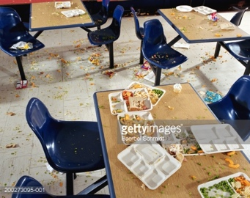
Have you ever left the lunchroom or courtyard looking like this?

Slide 4
Class discussion: Based on your understanding what are the expectations around food and drink in school?

Slide 5
According to your student planner…
Food and drink must be consumed in the cafeteria or courtyard ONLY
Students may drink water in other places if it is in a non-breakable bottle
Hallways and lockers should be free of food and drink other than sack lunches and water

Slide 6
***That means no snacking in the halls in-between classes***

Slide 7
4J POLICY
No glass, no soda or flavored drinks are allowed in classrooms.

Slide 8
Any questions or comments?

