Slide 1
FRIDAY IS ACADEMIC DAY
Notes:
Now into the overview.
Remind students that every Friday from here on out is an academic “check in” day.

Slide 2
Notes:
First, an announcement for students. “Bucks for snacks” is live in the cafeteria. These are the prices. You might want to tell them that a few students have already traded in bucks for IZZIs, so showing Cougar pride pays off.

Slide 3
What will we be doing on Fridays?
Check agenda planners (Any missing assignments? Any upcoming tests or due dates?)
Check and organize binders
Check progress in StudentVUE
Reflect on goals set on Monday
On some days students will have time to work on assignments and/or read silently
Notes:
Teachers will use the time to have check-ins with individual students in need of their support.
Teachers will scan agenda planners.
This is another largely independent day for students. An opportunity to check their academic standing and get support if needed.

Slide 4
6th Grade Only from here
Notes:
At this point, 7th and 8th grade students can can check academic planners (taking note of upcoming assignments, quizzes and tests), organize their binders, and get support from teachers.
6th grade continues with the PPT to learn more about StudentVUE. Walk them through this step by step. WEB Leaders should be there to assist.

Slide 5
What’s StudentVUE?
StudentVUE is an app and website that allows CY students to view their grades, contact their teachers and more.
It is incredibly beneficial as it can:
  Prevent you from falling behind in your classes
  Bring missing assignments to your attention
  Show you scores from recent tests and quizzes
This is how you access StudentVUE →

Slide 6
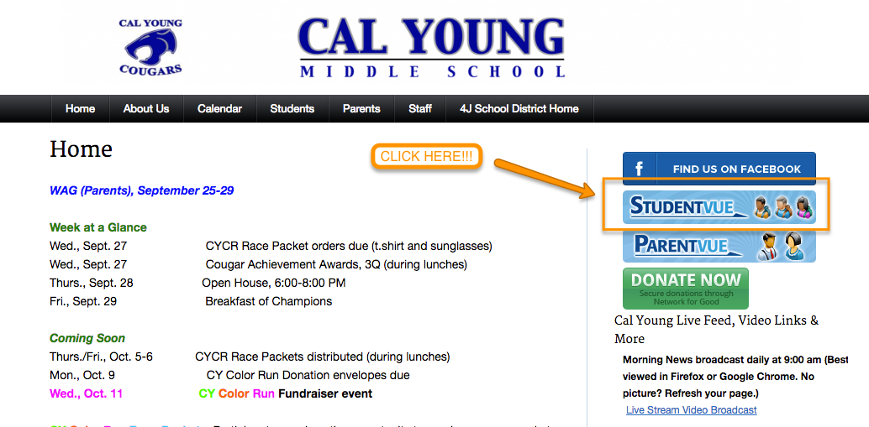

To access StudentVUE, visit the Cal Young website or click on the app symbol on your iPad
Notes:
The goal is to get students logged in, so they know how to do it moving forward. They can access it via the website or the app symbol.
Have WEB leaders make the rounds if you needed.

Slide 7
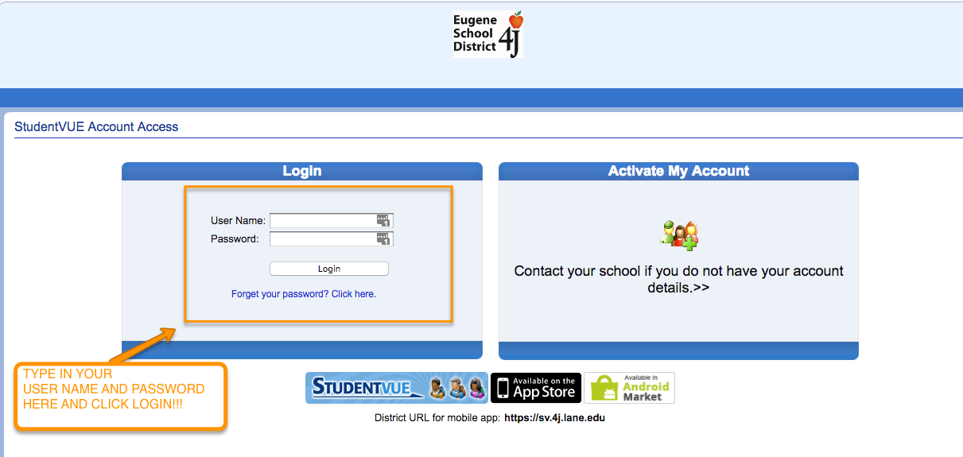
Next, you will type in your USERNAME and PASSWORD, and click “Login.”
Notes:
Check to make sure students know their username and passwords. If they don’t, make note of student and ask the tech people (not sure who) for assistance.

Slide 8
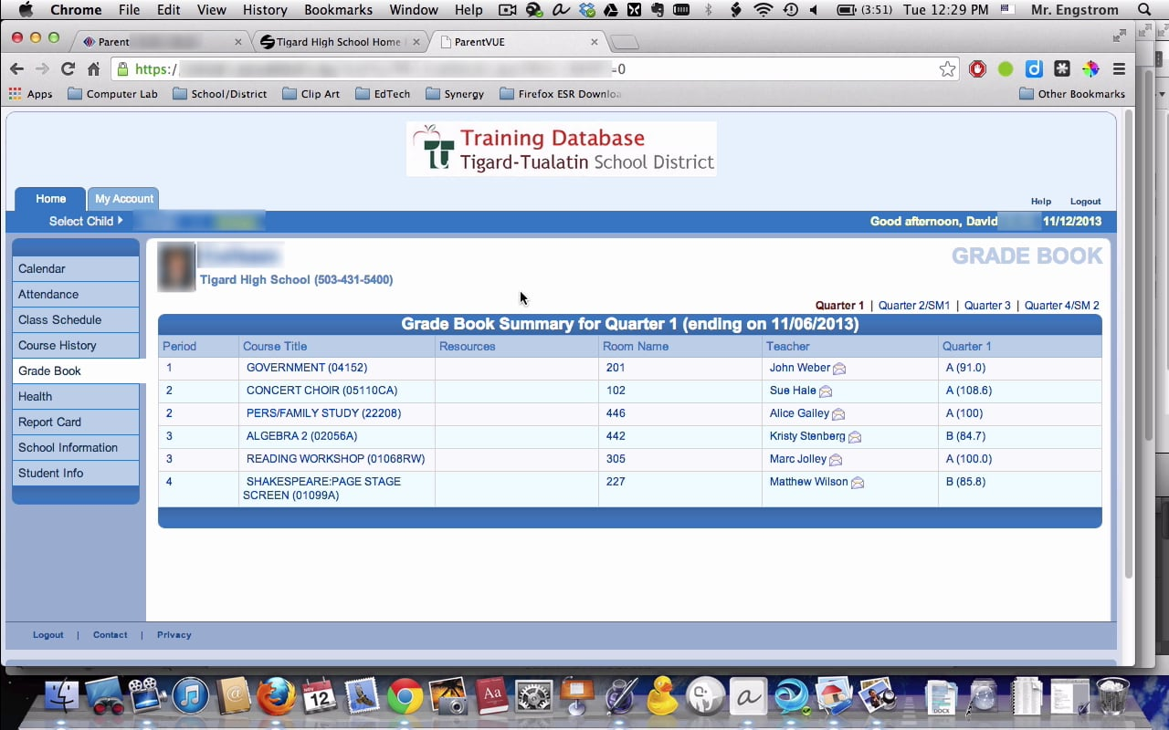
Once you’re logged in, you’ll be able to see a list of your classes. Click along the left-hand column to explored all of the features.
Notes:
If you have time, let the students look around a bit. You can curate this as you see fit.

