Slide 1

OMSI Outdoor Science School
Parent Information Meeting

Slide 2
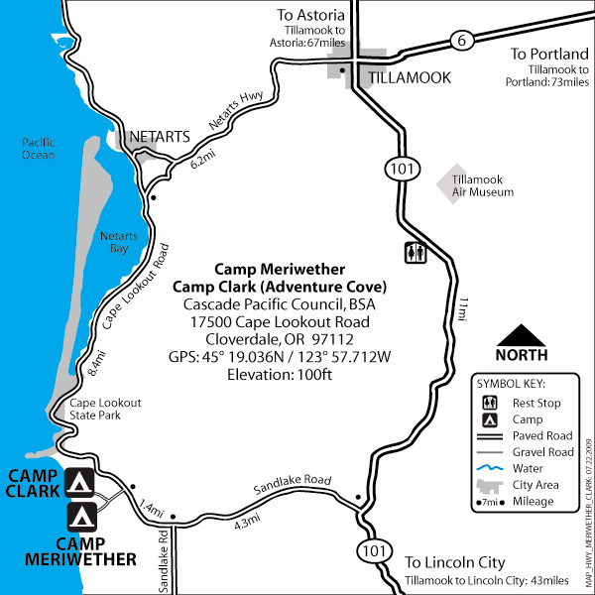

Slide 3
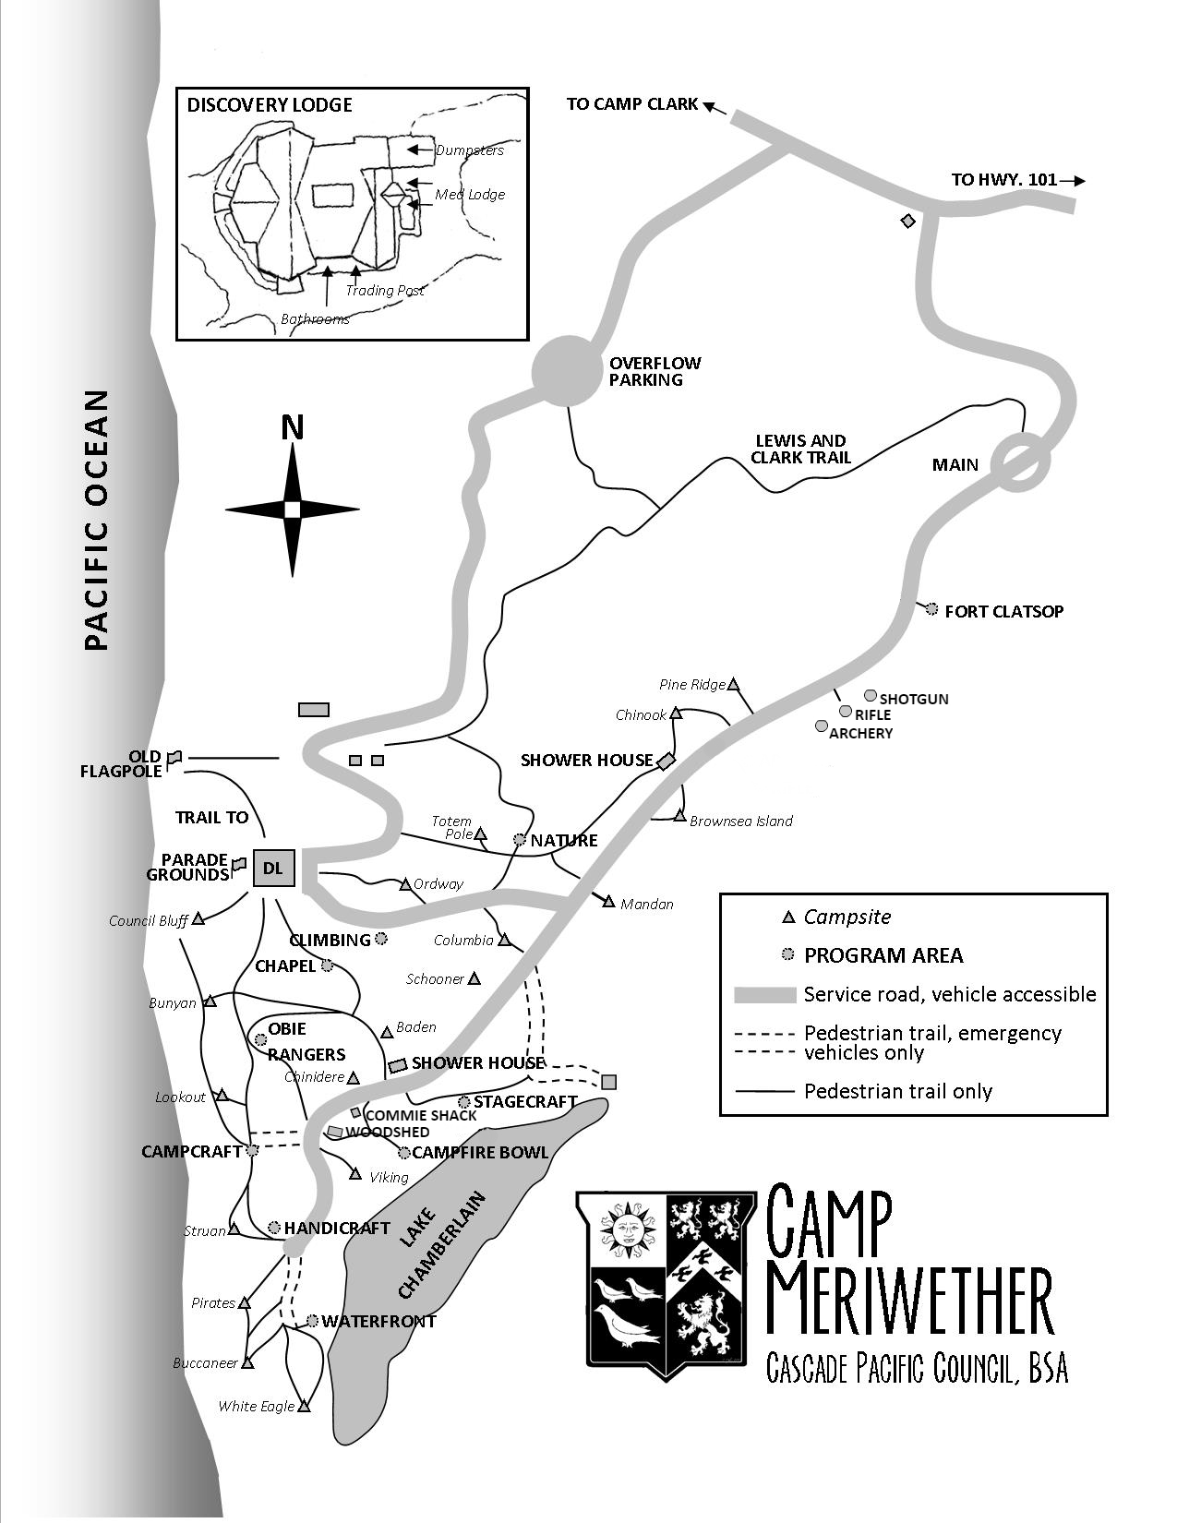

Slide 4
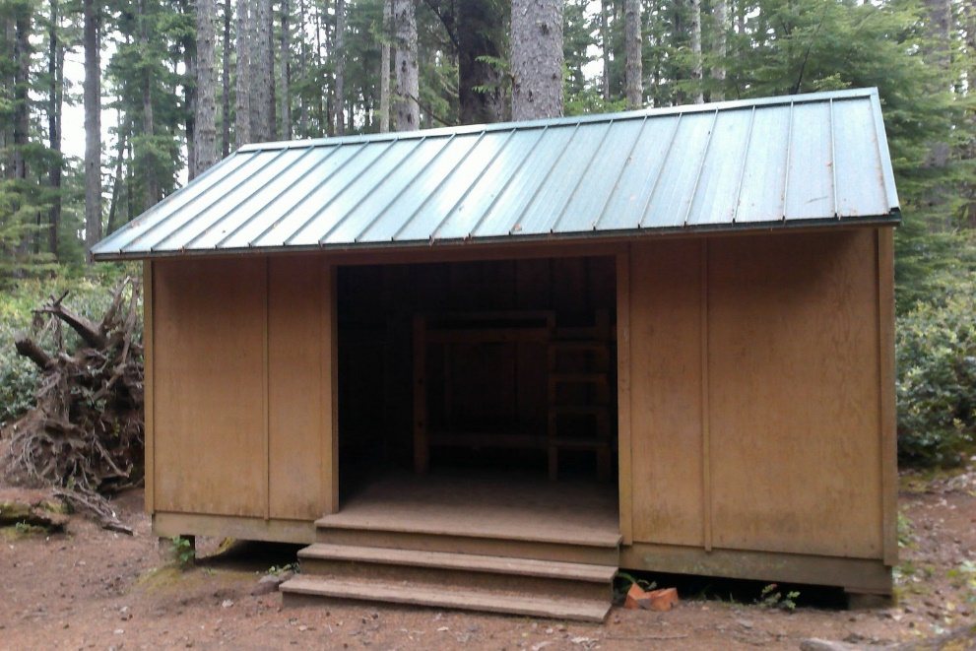
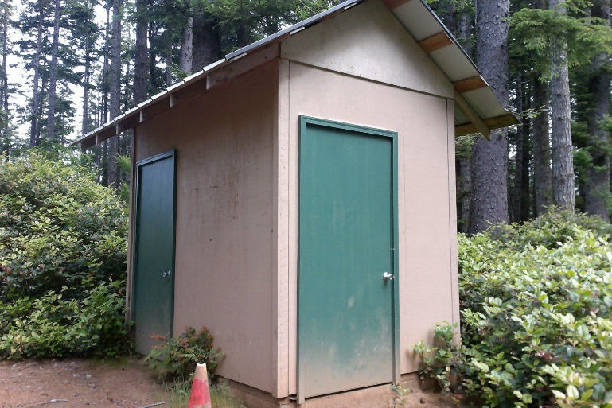
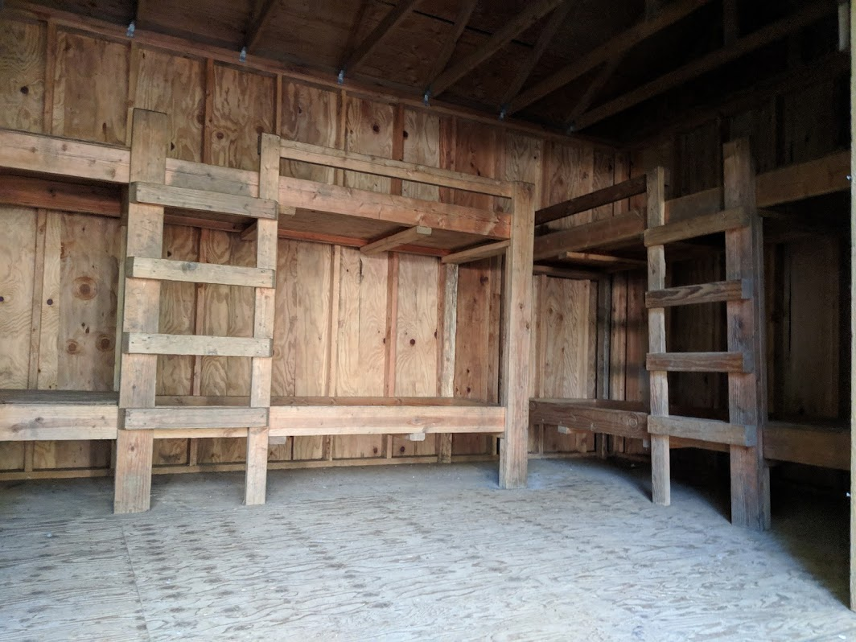
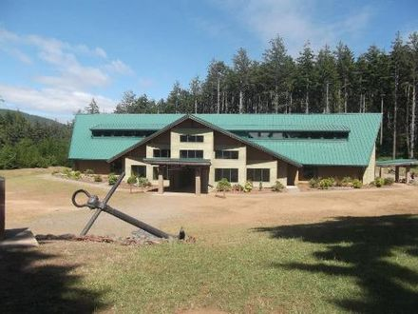
Pit toilets are located throughout the site
Each cabin sleeps 6
Dining Hall

Slide 5
Typical OMSI Schedule
Arrival Day
12:30 Lunch & Orientation
2:00 Introduction Hike
3:10 Snack
3:30 Shark Ecology
5:00 Rec Time
6:00 Dinner
7:15 Night Hike
8:30 OMSI Campfire
Full Day
7:30 Breakfast
8:45 Pack Lunches
9:15 Wind, Water, Waves
2:15 Cabin time
3:10 Snack
3:30 Skulls, Skins, and Bones
5:15 Rec Time
6:15 Dinner
7:15 Tsunamis in Cascadia
8:30 Campfire (school hosted)
Departure Day
7:30 Breakfast
8:00 Pack & Clean
9:00 Make lunches
9:30 Survival
11:15 OMSI Goodbye
12:00 Bus drives away

Slide 6
Packing List
Standard Field Gear (in red) is what we ask all students, chaperones, teachers and OMSI staff to wear during activities. Please keep this list in mind when packing for OMSI Outdoor Science School. All participates must bring a lunch for the first day of their program.
Clothing:
Two pairs of shoes that are well broken-in. One for out in the field, and a backup pair, if they get wet
Multiple pairs of socks (wool sock preferred, but not required)
Two pairs of pants, long enough to cover the ankles
Appropriate number of t-shirts
Warm layers for under rain gear (preferably not cotton)
Rain Jacket or poncho
warm hat/gloves (optional)
Personal Gear:
Toiletries (toothbrush/paste, hairbrush, soap)
Washcloth and towel
Sunscreen
Optional:
  Reusable lunch bag/containers
  Camera
  Cash or check to purchase goods in the OMSI Store
  For adults only: reusable travel mug

Slide 7
Packing List
Other:
Two reusable water bottles, filled at the start of each activity.
A sturdy day pack to hold water bottles, lunch, notebook, pencil, and other gear.
Please do not bring:
Electrical equipment (cell phones, radios, computer games, blow dryers)
Snacks or candy (it attracts rodents and they will damage your gear.)
Sleeping/ Nighttime:
Warm sleeping bag (pack an extra blanket if needed)
Pajamas
Pillow (can be as simple as a stuff sack that can be filled with clothing)
Flashlight/headlamp for in bunk reading and travelling around camp after dark
All clothing and gear should be marked with the owner’s name. OMSI is not responsible for lost or broken items. Found items will be kept on site for two weeks. Please call your group leader as soon as possible to arrange for their return. Unclaimed items will be donated to charity.

Slide 8



Notes about Weather
The Oregon coast is known for its diverse weather, meaning that in the same day we can have sunny skies in the morning and pouring raining in the afternoon.
You may be fortunate to have a week of clear skies, or you may experience precipitation of any form, from hail to rain.
When planning your trip, it is wise to plan for all kinds of weather. For the health and safety of your participants, everyone must come prepared with waterproof rain gear and warm clothes.

Slide 9

OMSI Outdoors Program Rules and Policies
Teachers and parents, please read through the policies with your student(s) so that everybody arrives on site already familiar with the expected community behaviors
The goal of these policies is to ensure you have the opportunity to build academic and social skills in a safe environment.
Discipline Actions
Step 1: Instructor/chaperone talks to the student about behavior.
Step 2: The student agrees upon a verbal contract with teacher and manager.
Step 3: A contract is written and signed by student, teacher, and manager about the students behavior. Parents are notified about the situation.
Step 4: Further disciplinary action will be determined by the teacher which may include asking the parent/guardian to remove the student from the program.

Slide 10
Health, Safety, and Emergency Procedures
Parents release their students to your school during OMSI programs. As a result, teachers/group leaders and chaperones/counselors are responsible for responding to all medical concerns.
Medications:
All medications must be in their original containers, and stored in a locked container.
The Health Officer dispenses all medications, unless that responsibility has been delegated to another adult when the student is in the field.
Each student must be told it is their responsibility to report to the Health Officer at the proper time to receive medications.

Slide 11

OMSI Outdoors Kitchen Notes
OMSI Outdoors prides itself on having meals that are nutritious and homemade.
Vegetarian, dairy-free, gluten-free, and other diets can be accommodated as needed. OMSI Outdoors can provide foods made without a given allergen, but our facility is not a dedicated allergen-free kitchen.
If any participate has a life-threatening allergy to a particular food, contact the Program Coordinator immediately to discuss if the family should send supplementary food.
All pertinent dietary information should be delivered to the Program Coordinator at least two weeks in advance so the kitchen staff can be prepared.

Slide 12

Kitchen Notes (Nuts)
Nuts and nut oils are not used in our cooking, however, we may use foods that may contain traces of nuts, or were processed in a factory that also processes nuts.
Peanut butter and jelly sandwiches are always made at a table that is separate from all other lunch items to avoid cross contamination.
If participants have an airborne allergy, peanut butter will be removed from the dining hall and homemade sunflower seed butter will to available instead.
Depending on the severity of the allergy, all peanut products can be removed from the kitchen entirely for the duration of the week.

Slide 13

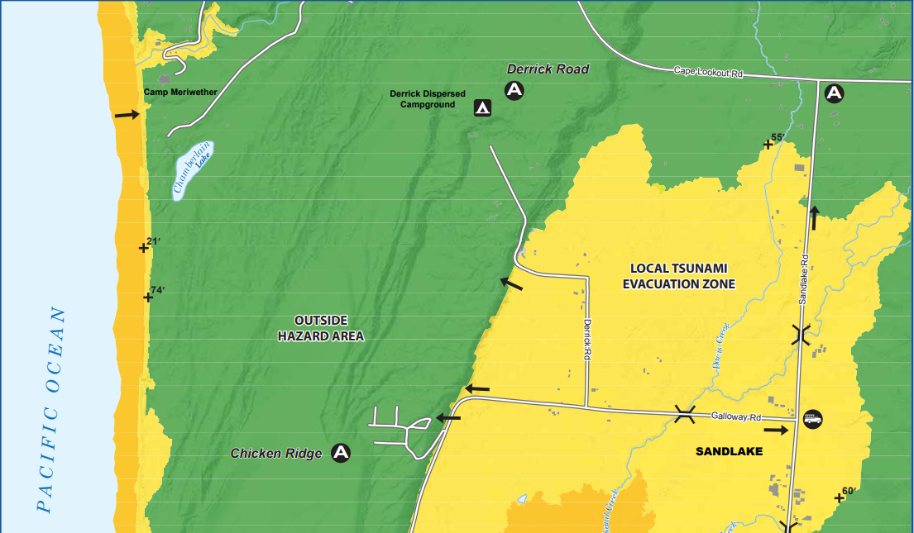
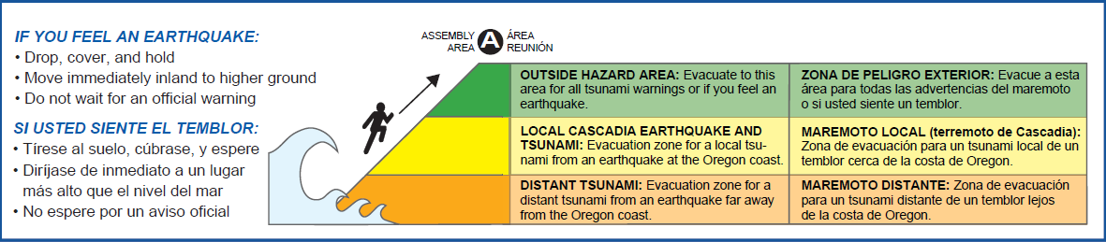

Health, Safety, and Emergency Procedures
Camp Meriwether is located in a tsunami inundation zone meaning in the event of a tsunami, our site is in an area that may become quickly flooded. We follow Camp Meriwether Tsunami evacuation plan

Slide 14

Receiving Mail
We are asking parents to send mail to the students’ teachers 2 weeks prior to camp. Please drop these off at school but do not let the kids know. It is our intention that students will receive mail from home to help keep them going. We are asking for ___ letters to be written and sealed in an envelope so that kids can receive mail from home during camp. These are to be letters that don’t include any kind of snack, candy, food item.

Slide 15
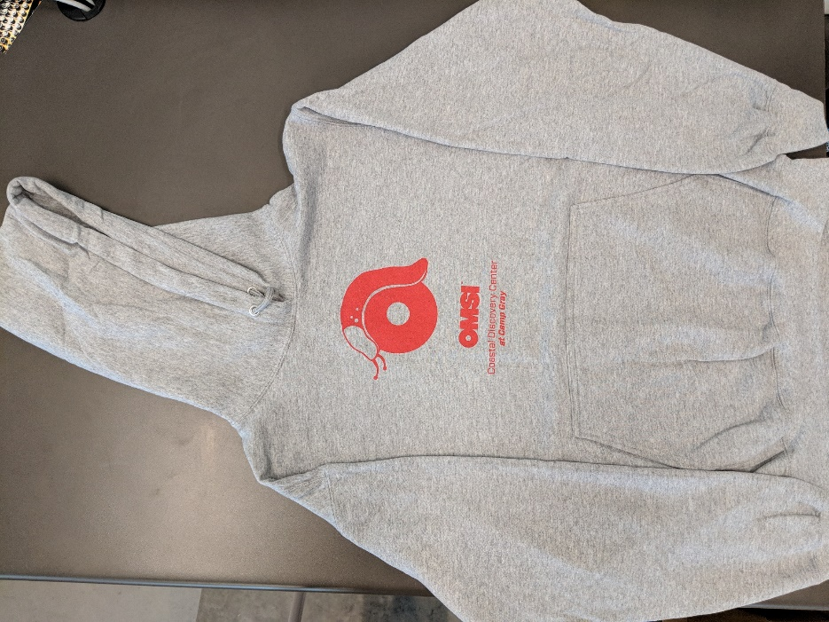
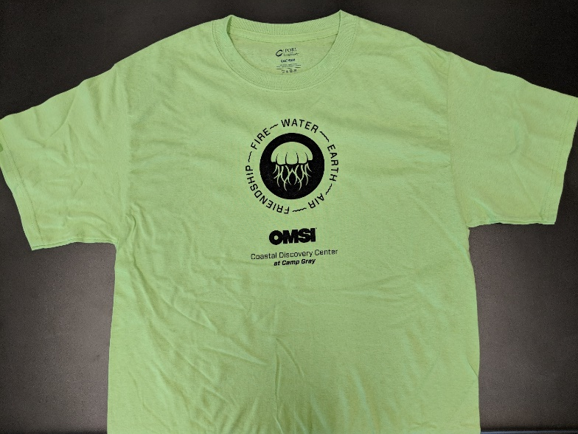


OMSI Outdoors Store
OMSI Outdoors souvenirs are for sale on site.
Group leaders may opt out of the store for their students.
T-shirts are $10
Hooded Sweatshirts are $25
Please contact the Program Coordinator if you have any questions regarding the OMSI Store.

Slide 16

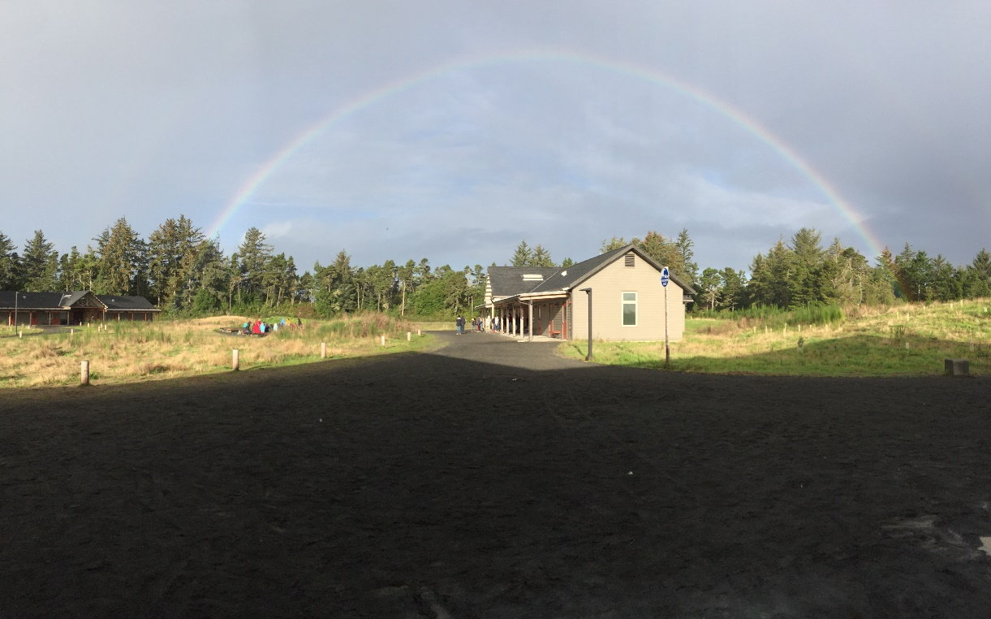
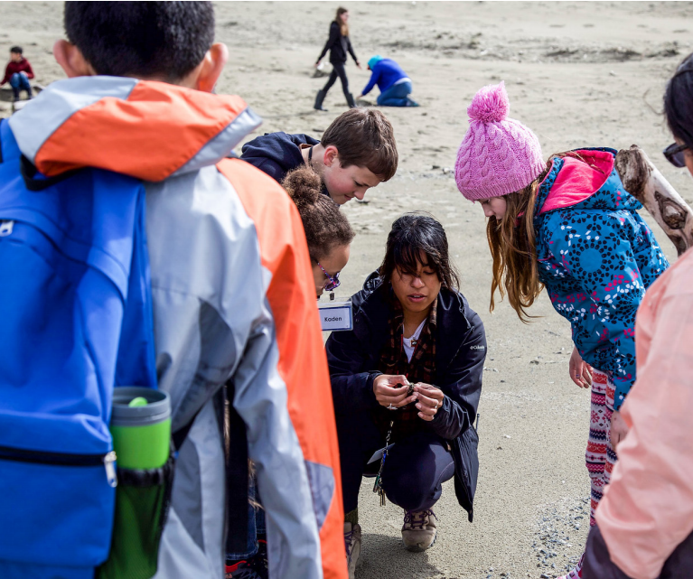
Any Questions?

