Slide 1
Introduction to Ellevation for Classroom Teachers
TLC - Feb. 2019

Slide 2
Overview
Ellevation is a data, reporting, and collaboration platform designed to support ELs and their teachers.
The program is available to all teachers, specialists, and administrators in the district.
Ellevation will allow us to save time and paper.

Slide 3
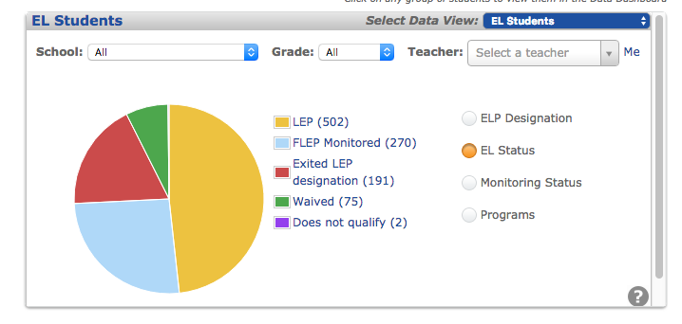
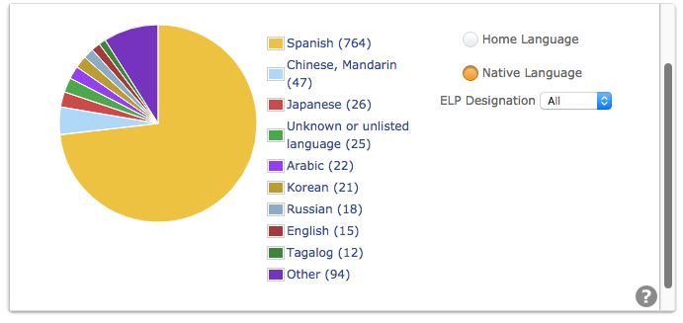
Data Dashboard
An example of the data available:
Total # of ELs in 4J (Feb. 2019)

Slide 4
Monitoring
What does this mean for me?
Beginning this spring, monitoring of exited and waived students will be streamlined through Ellevation.
What’s the same?
The state requires that we monitor academic progress for students who exit ELD for 4 years.
Monitor Year 1 & 2 students will be monitored in the fall and spring.
Monitor Year 3 & 4 students will be monitored in the fall.
Teachers will be asked to complete a short survey.

Slide 5
Monitoring
What’s new?
Paperless Monitoring - Teachers will receive an email from Ellevation with a link to the survey which will be completed and submitted online.
Monitor Year 3 & 4 - Beginning in fall 2019, only students whose fall monitoring indicates a concern will be monitored again in the spring.
Waived Students - Once a year, we will be monitoring students who qualify for ELD, but have a parent waiver. (As of 4/8/19 = 75 students K-12)
Monitoring Feedback - Will be available for school support teams to view, along with other data, that can help guide decision making.

Slide 6
Monitoring
Which teachers will complete the survey?
Elementary: Fall & spring - Homeroom teacher
Middle School:
Fall - Content Areas, Support Classes
Spring - Content Areas, Support Classes
High School:
Fall - Content Areas, Support Classes
Spring - Content Areas, Support Classes
Notes:
In the past all core content teachers at the secondary level have been asked to complete the monitoring survey.

Slide 7
Monitoring
Creating an Account:
Classroom teachers will be able to create an account with this link: Self Registration Link for Classroom Teachers
https://login.ellevationeducation.com/Registration/SignUp/7u50e5
Timeline for this year:
April 10 - Designated teachers with monitored or waived students will receive an email from Ellevation with a link to the monitoring form.
May 3 - Monitoring forms are due.
Timeline for future years:
Fall - Monitor forms distributed October 15, due October 31.
Spring - Monitor forms distributed February 15, due March 1.

Slide 8
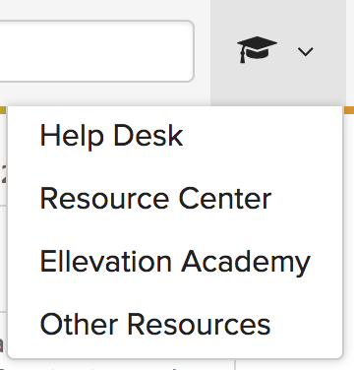
Support
Where can I get help?
Ellevation Help Desk → Button in the lower right corner of your screen.
Ellevation Resources → Click on the graduation cap located in the menu bar.
ELD Teacher at your school
District ELD Program Coordinator – Lily Gold
TLC 2/2019

Slide 9
Questions?
TLC 2/2019

