Slide 1
The Zimmerman Telegram
And the role of spies, trust, and intelligence in history.

Slide 2
But first, a journal.
What makes/fosters nationalism? Why do people fight for their country?

Slide 3
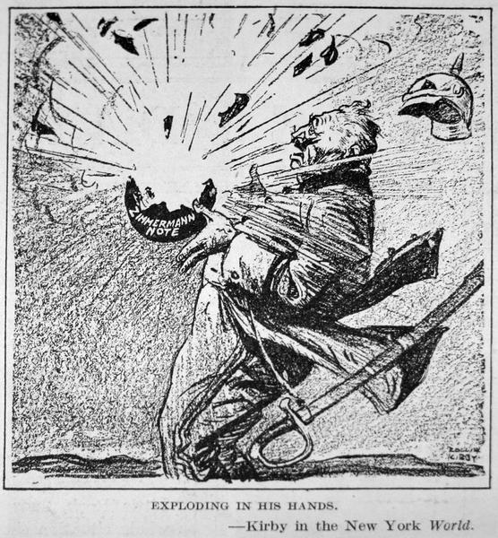
Context - 1915
US switches support from Villa to Carranza
Villa raids US - Two interpretations
Seizing arms
Retribution
Pershing invades Mexico
WWI
Central v. Allies
US in disputes w/ Germany
German interest in Mex. Rev.
Why? What is most important commodity in war in 20th c?
Lusitania
Rowlan Kirby - USA

Slide 4
Carranza Response
Receives and gives most support to/from Germany
Carranza in need of military supplies and international support
Germany in need of oil and to distract US
Pershing STILL unable to seize Villa
Successful for a time

Slide 5
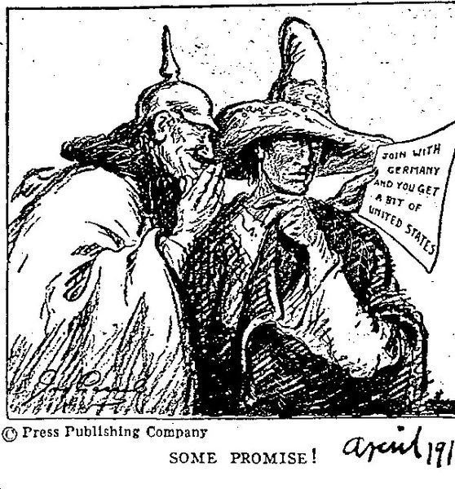
The Telegram
Issued by German Foreign Minister Arthur Zimmerman in Germany in 1917.
Intended to go from Germany through US and end in Mexico
Seized by UK and decoded and sent to US
Content
Germany seeking alliance w/ Mexico - Either military or financial support
Mexico expected to go to war with US to retake territory taken in Mexican-American War
Japan also invited to party - Mr. Anchondo is not :((((

Slide 6
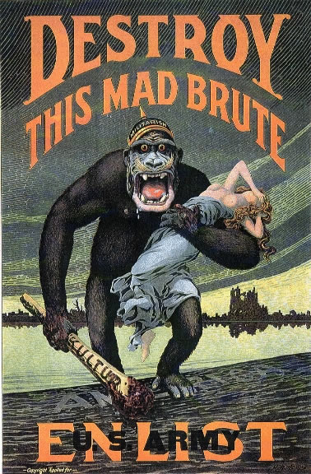
US Response
Entry to WWI still very unpopular through 1917
Wilson re-elected on a “He kept us out of war” campaign
Congress still opposed to war
Wilson uses telegram to increase support for war
US declares war on Germany and Central Powers in April, 1917
H.R. Hopps - USA

Slide 7
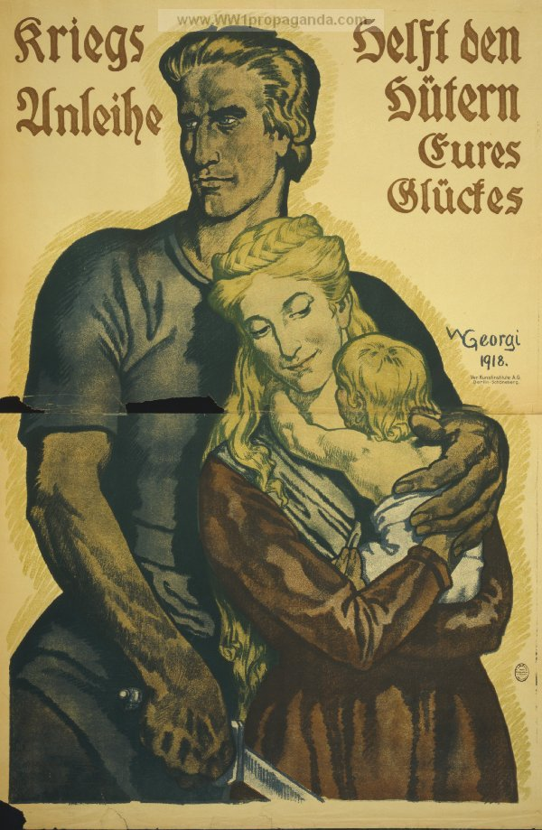
German response
Telegram itself is controversial
Why?
Begins arming Villa in hopes of creating alliance between Villa and Carranza against US
Continues publishing anti-US propaganda in Mexico
“War loans help the guardians of your happiness.”

Slide 8
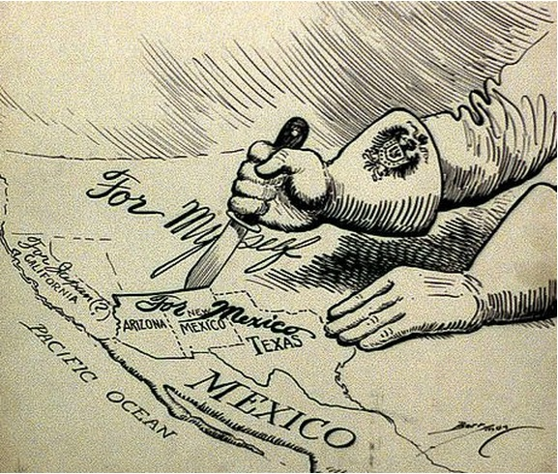
Mexican Response
Due to Pershing pursuing Villa, Carranza relations w/ US improved
Carranza still fearful of US seizure of oil fields
Carranza needs a DTR with Germany
Ultimate response: Mexican neutrality
No ability to retake land
Fear of US retribution if sided with Germany
Clifford K. Berryman - USA

Slide 9
Obviously, an OPVL

