Slide 1
The Constitution of Mexico (1917)

Slide 2
Journal
What purpose does a constitution serve?
Give rights to people?
Restrict power of government?
Give framework to government?
Plan economy (Article 27)
Restrict power of special interests/religion
Establish ethical standards for society

Slide 3
Constitutional Convention 1917
Diverse cross-section of revolutionaries
Far less religious than general population
Constitution – radical for era
Endorses land reform – Art. 27
Private property not absolute right
Fed gov’t can nationalize private, Church & foreign investments
Worker’s rights – Art. 123
Increased Presidential power, but only 1 term
Restrictions on RC Church - Art. 3 & 130
Not popularly supported - Why?
IMPACT: Changes force future Mexican rulers to address working and peasant classes

Slide 4
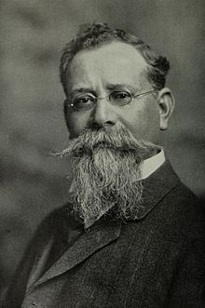
Article 3
Pushed by:
Carrancistas
Content:
Right to a free and secular education
Why so important?
Guaranteed elementary education
Effect:
Opposed by Catholic Church
Why?
Enforcement handled locally
Resulted in uneven education
Some places saw reduced access to education due to firing of Catholic teachers and shutting down of Catholic schools

Slide 5
Article 27
Pushed by:
Zapatistas and Villistas
Inspired by Plan de Alaya
Content:
Private property not absolute right
Fed gov’t can nationalize private, Church & foreign investments
Only Mexican citizens/companies may own Mexican land
Gov’t owns all subsoil and it’s contents - paved way for nationalization of oil
Effects
Significant land reform/gains by peasants
Revolutionary leaders able to increase land claims

Slide 6
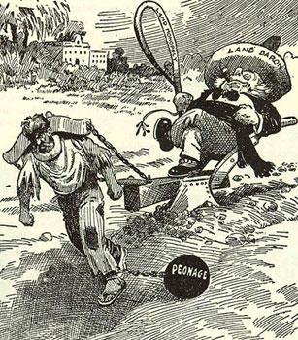
Article 123
Pushed by:
Carrancistas
Content:
8 hr work day
Equal wages based on gender and nationality protected
Guaranteed overtime
Right to unionize
Right to strike
Paid maternity leave
Effects:
Most progressive legal working rights in Americas at time

Slide 7
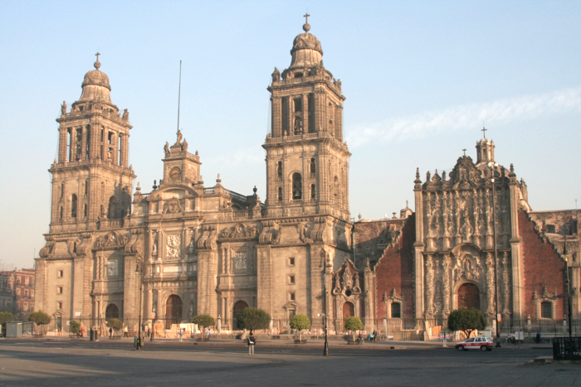
Article 130
Content
Separation of church and state
Prevention of priests being elected to office
Public registration of priests
Church property nationalized
Effects
Not enforced by Carranza as president

Slide 8
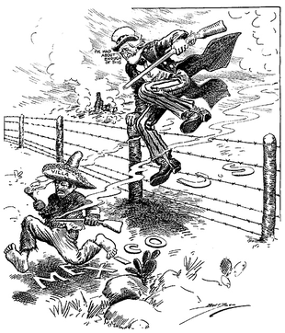
Implementation and Effects
Unevenly enforced
Article 27
Revolutionary leaders see significant land gains
Obregon 150 ---> 3,500 hectares
Inspired other Latin American Constitutions
Massive improvement in status of women
Legalized divorce, paid maternity leave, equal pay
Right to vote in federal elections not realized until 1953
Huge pushback by Catholic Church
Increase in power of President
No VP, weak legislature

