Slide 1
Art of the Mexican Revolution with a side of a love triangle

Slide 2
Duh, it’s journal time.
What piece of art (Music, Painting, Drawing, Play, Novel, Sculpture etc) has made you feel the most emotion? Has art ever moved you to action?

Slide 3
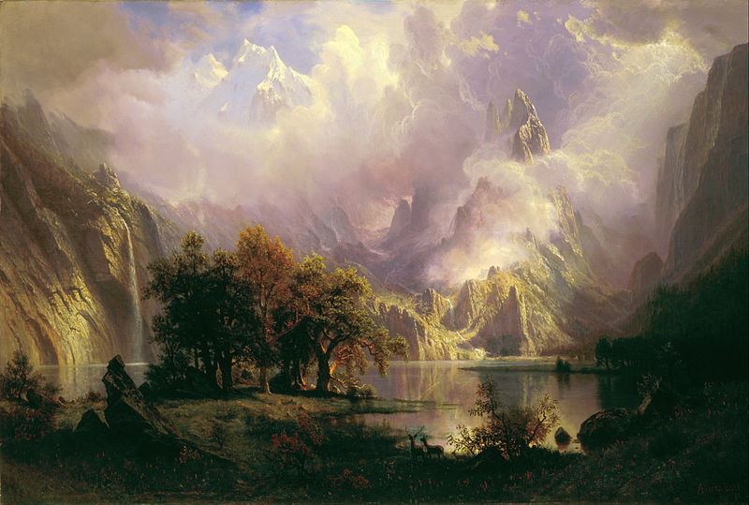
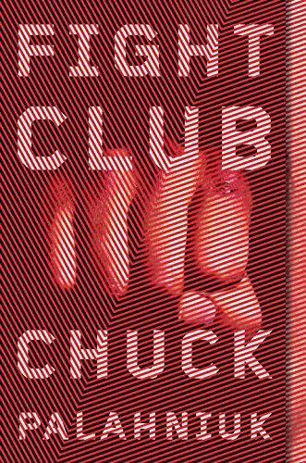
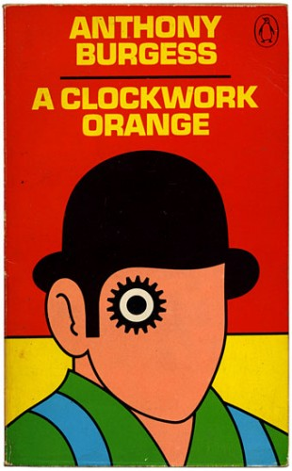
https://youtu.be/t3217H8JppI
Bierstadt - Among the Sierra Nevada, California

Slide 4
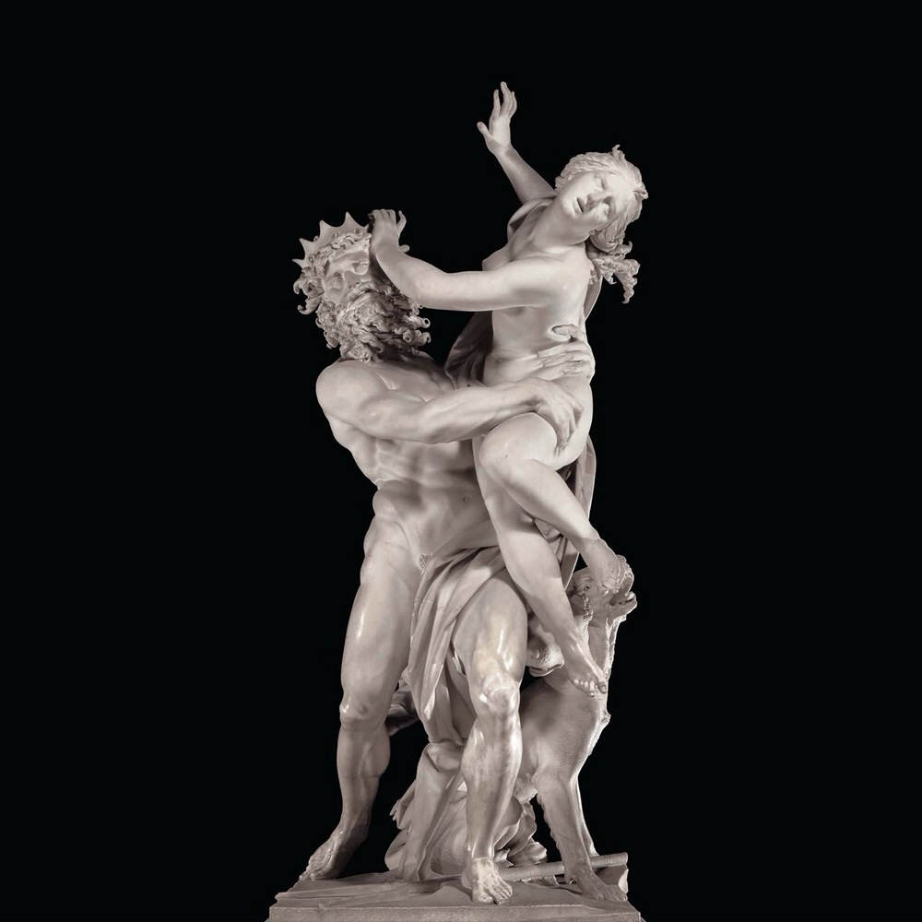
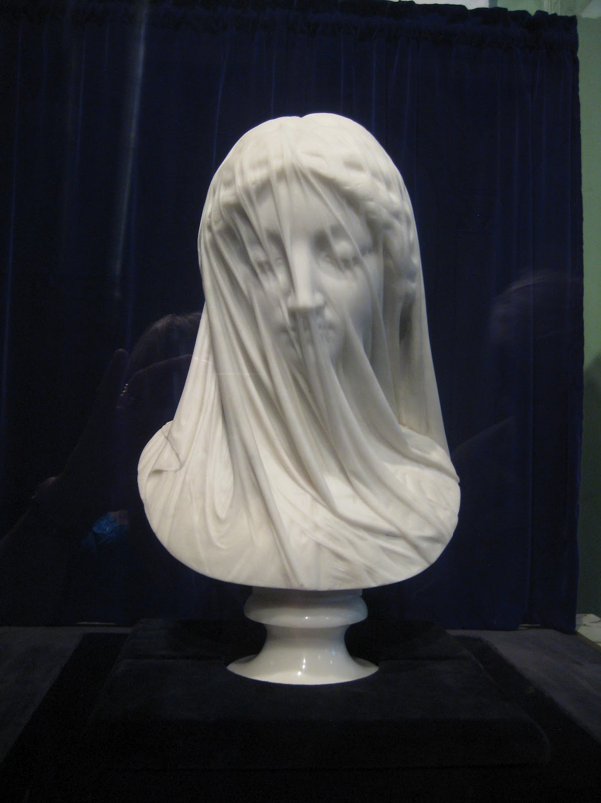
Bernini - Apollo and Daphne | The Veiled Virgin
https://www.youtube.com/watch?v=oRG2jlQWCsY
https://www.youtube.com/watch?v=QrY9eHkXTa4

Slide 5
Diego Rivera and Secretariat of Public Education
Covering all of the walls of these two courtyards are murals. 235 panels or 1585.14 m2 of this mural work was done by Diego Rivera between 1923 and 1928
Take that Michelangelo
Depict history of Mexico from pre-hispanic times
Marxism and class divisions emphasized
Focus on quotidian people
Why?

Slide 6
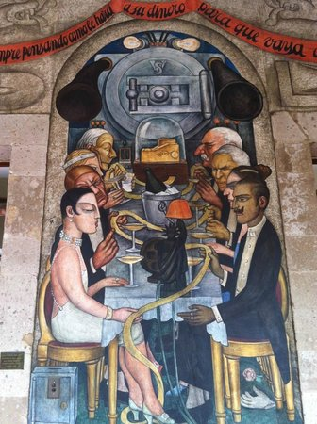
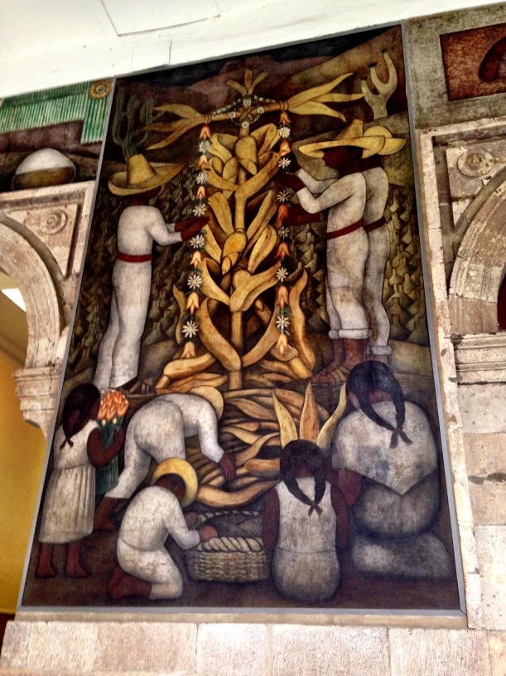
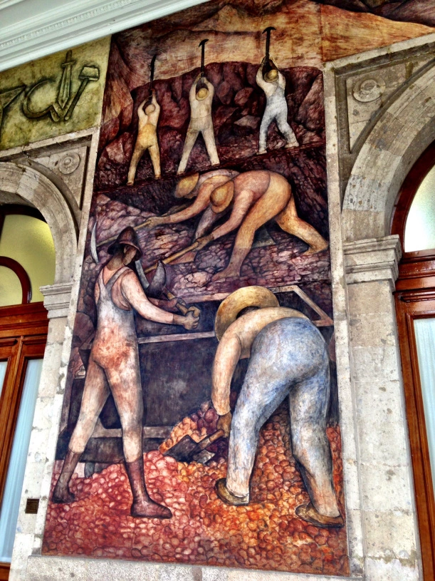

Slide 7
Rivera - Epic of Mexico - National Palace
https://upload.wikimedia.org/wikipedia/commons/1/11/Murales_Rivera_-_Treppenhaus_6.jpg

Slide 8
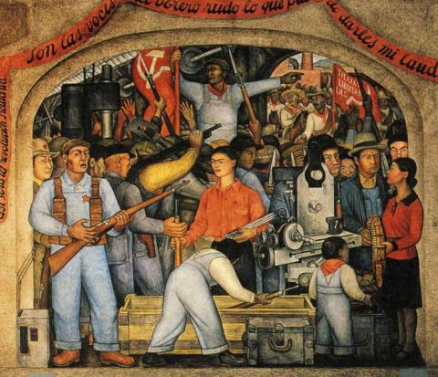
The Weapon Arsenal by Diego Rivera

Slide 9
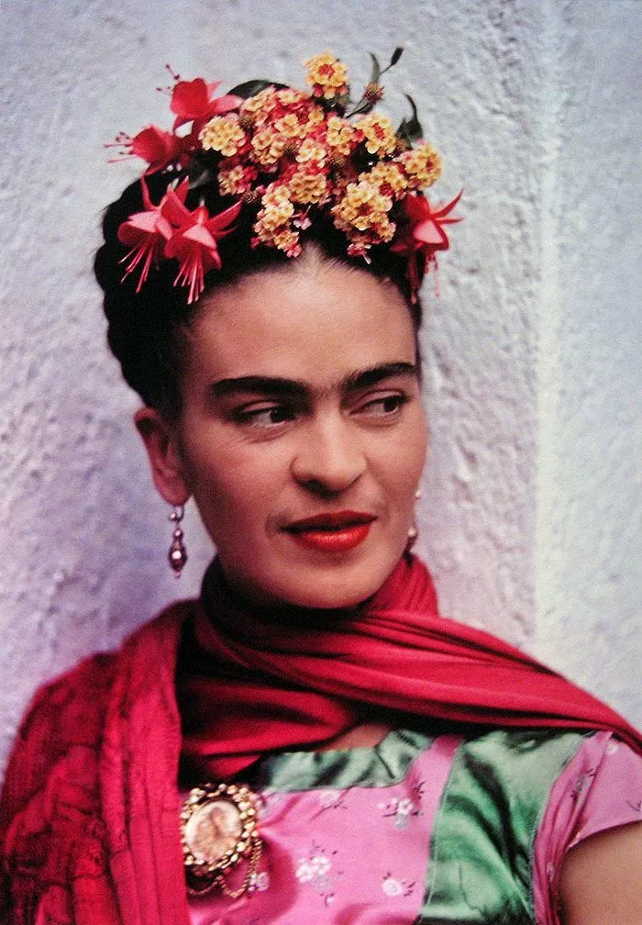
Frida Khalo
Frida Kahlo photographed in 1938 by Nickolas Muray (Photo: Throckmorton Fine Art)
Born and raised in Mexico City
Hit by bus at 18
Significantly impacts her life, art, and self-image
Joined Communist party while in college
Marries Diego Rivera

Slide 10
Art of Frida
Focused on self-portraits
Adopted characteristics of Mexican nationalism, surrealism (a label she rejected), and pro-indigenism themes in later career
Likely influenced by Trotsky, Rivera, and Communism

Slide 11
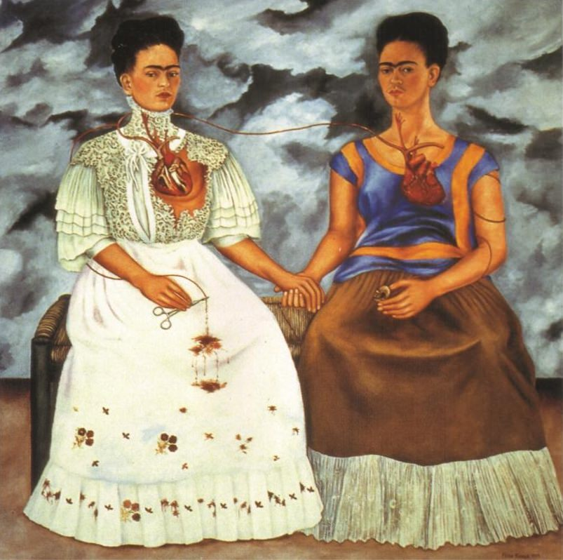
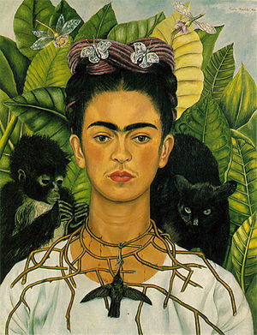
The Two Fridas
Self-Portrait with Thorn Necklace and Hummingbird

Slide 12
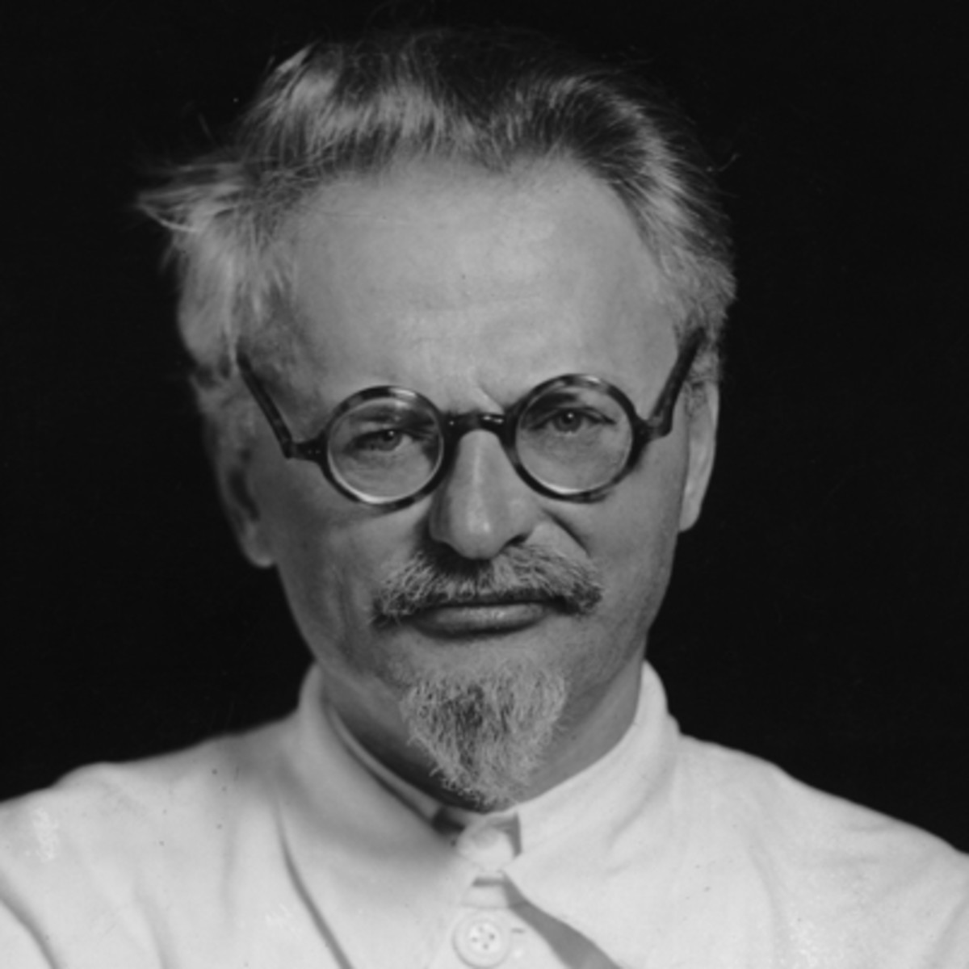
Oh yeah, Trotsky
Marxist Revolutionary
Lead Red Army against Whites in Russian REvolution, handled following transition of power
Due to philosophical differences with Stalin, exiled in 1929
Lived in Mexico in 1939 with Khalo and Rivera
Assassinated in Mexico City in 1940

