Slide 1
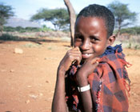
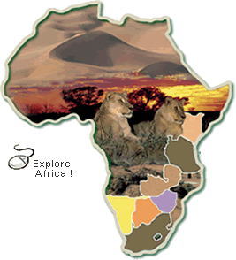
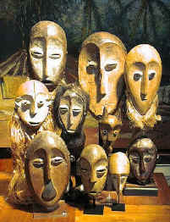
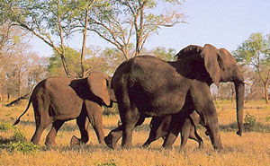
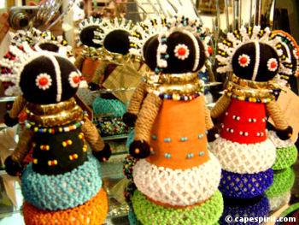
Images of Africa
Notes:
‹#›

Slide 2
People often have some ideas about Africa that are just not true Here are the top 10 …
Notes:
‹#›

Slide 3
The Top 10 Myths about Africa
#1 The ancient African civilizations did not have a major impact on the world like other ancient civilizations did.
#2 African social organization is by tribes while Europeans are organized by nationality.
#3 The lifestyle, arts, and technology in Africa are primitive compared to the rest of the world.
#4 Africans don’t have literature or philosophy.
#5 Real Africans are black and of African origins.
#6 Africa is a country and all the people there speak “African”.
#7 The African continent is mostly “jungle” or tropical rainforest with a few deserts and overpopulation everywhere.
#8 North Africa is not part of Africa.
#9 Africans are not capable of solving their own problems.
#10 Africa is a continent of misery and problems.
Notes:
‹#›

Slide 4
#1 – The ancient civilizations of Africa did not have an impact on the world like the other ancient civilizations did.
Notes:
‹#›

Slide 5
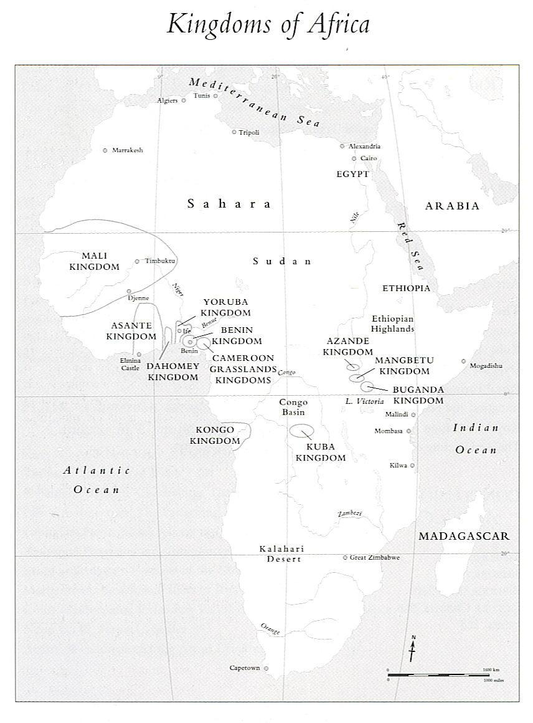
There were several ancient African kingdoms that were often mentioned in the books of ancient travelers. The Kingdoms of Mali, Songhai and the Great Zimbabwe are just a few examples. These kingdoms had specialists such as artisans, storyteller historians (griots), merchants who traveled great distances all over the world. In addition, there are some historical sites, like Timbuktu in Mali, that are recognized by the world as centers of trade and scholarship.
Notes:
‹#›

Slide 6
#2 Africans identify themselves by tribes while Europeans identify themselves by their nationality.
Notes:
‹#›

Slide 7
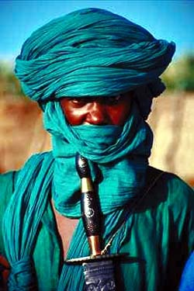
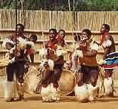
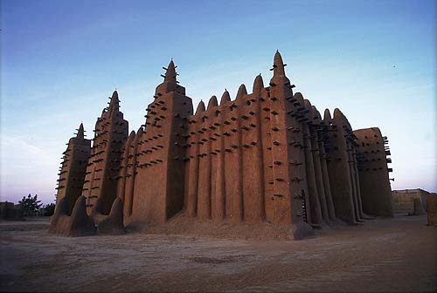
The word tribe was used by the Europeans to talk about African ethnic groups. It has a somewhat negative meaning, in that it implies that they are different than us. In Africa, traditional lifestyles were based on family and extended family or community relationships, just as they were in Europe in times past. And, just as in Europe or elsewhere, the growth of cities and mix of diverse populations in contemporary societies is causing these traditional relationships and family structures to change; particularly with the large scale migration of young people to cities.
Notes:
‹#›

Slide 8
#3 The lifestyle, arts, and technology in Africa are essentially primitive compared to those of other cultures.
Notes:
‹#›

Slide 9
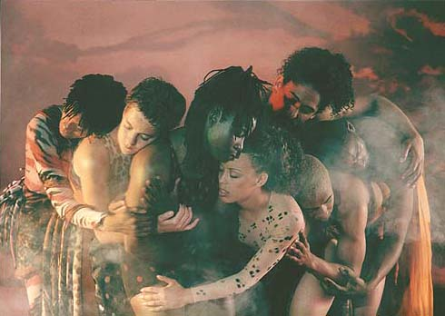
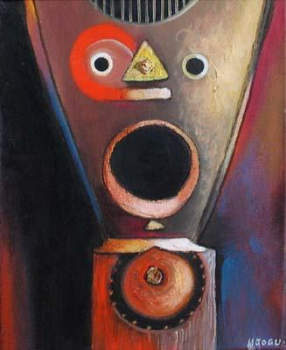
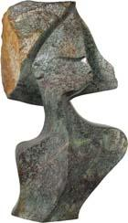
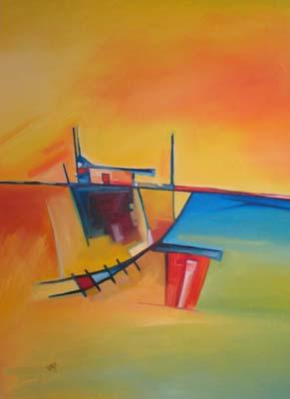
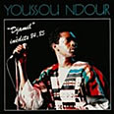
MODERN AFRICAN ART AND ARTISTS
sculpture
dance
Boy Becomes Man Njogu Touray
Modern Shona stone sculpture
MUSIC
Same Old Ways by Charles Nkomo
Notes:
‹#›

Slide 10
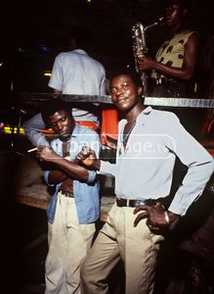
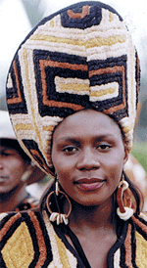
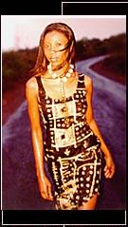
City Nightlife
African designers and Contemporary Fashion
Business & Technology
Notes:
‹#›

Slide 11
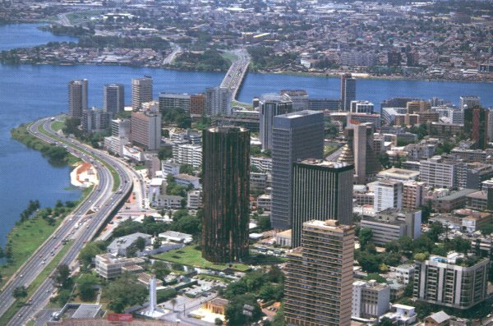
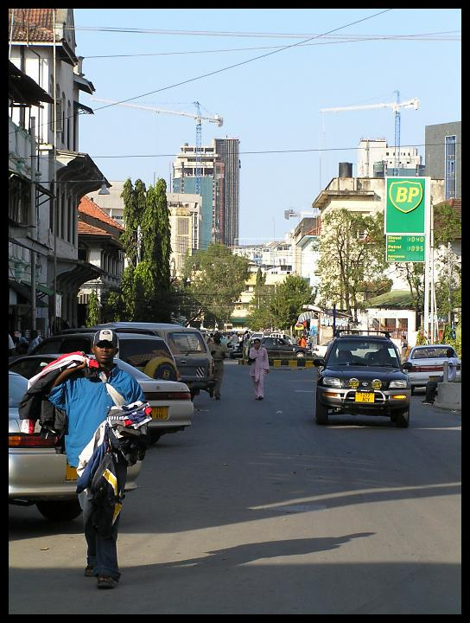
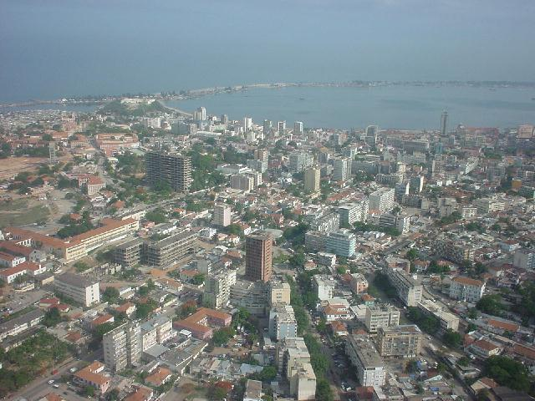
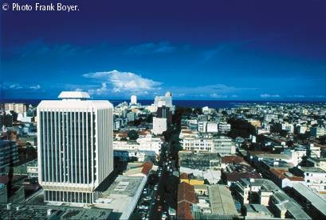
DAR es SALAAM, Tanzania
ABIDJAN, Cote d’Ivoire
LUANDA, Angola
DAKAR, Sénégal
Notes:
‹#›

Slide 12
#4 Africa doesn’t have literary or philosophical traditions like other places.
Notes:
‹#›

Slide 13
AFRICAN WRITERS INDEX (retrieved from www.geocities.com/africanwriters)
African Oral Literature Oral Artists,Oral tales,Warrior Poetry Dynastic Poetry Afrikaner Literature Afrikaans PoetryAfrikaans Prose
Amharic Literature Oral,Modern
Anglophone Literature Poetry Prose
Arabic Literature Maghreb Egyptian
Children's Literature Traditional Contemporary
Creation Myths By countries Themes
Francophone Literature Poetry Prose
Lusophone Literature Angola Mozambique Negritude Articles Poetry, Prose
Non-fiction Essays,Travel
Post-Colonial Literature > Liberation Struggle,Black ConsciousnessCold-War
Swahili Literature Traditional,Contemporary
Women's Literature Poetry,
Young Adults Pre-teens,Twentysomethings
Zulu Literature Oral,Contemporary
Notes:
‹#›

Slide 14
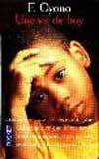
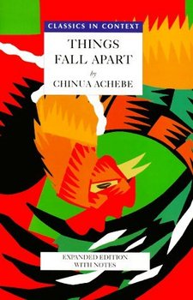
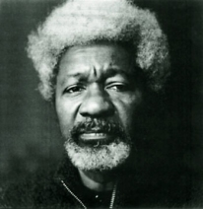
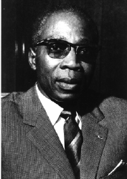
African writers and philosophers have existed at least since the days of the great library at Timbuktu.
The political movement called the “Pan-African movement” and the call for independence of African states was first conceived by the writers and poets of the literary movement called “négritude”, which called on Africans to reject becoming like their colonial rulers, and to return to their African identity and honor their unique cultural values and lifestyle. This battle of ideas was fought by the words of the young writers and poets of the 1950’s who became the presidents and statesmen of the newly independent states of Africa.…
Léopold Sédar Senghor of Senegal
Kwame Nkrumah of Ghana
Jomo Kenyatta of Kenya
Cheikh Hamidou Kane of Guinea
Wole Soyinka, Buchi Emecheta and Chinua Achebe of Nigeria
Ferdinand Oyono of Cameroon
Notes:
‹#›

Slide 15
#5 Real Africans are black and are originally from Africa.

Slide 16
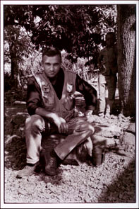
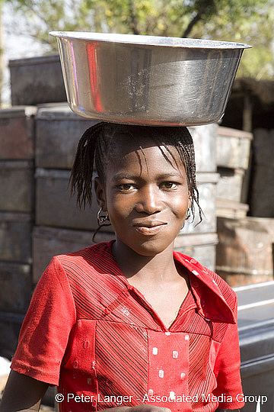
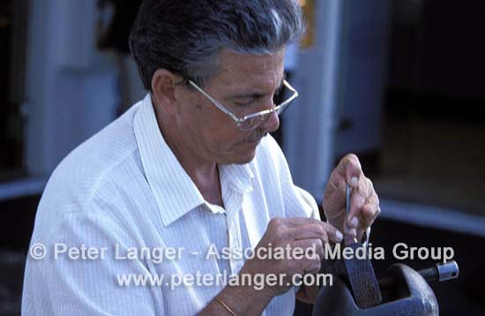
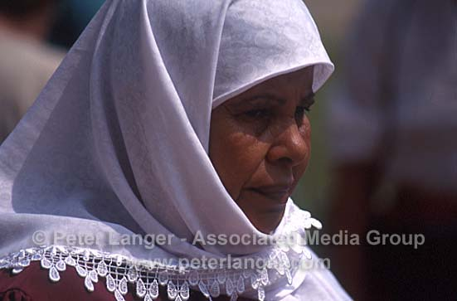
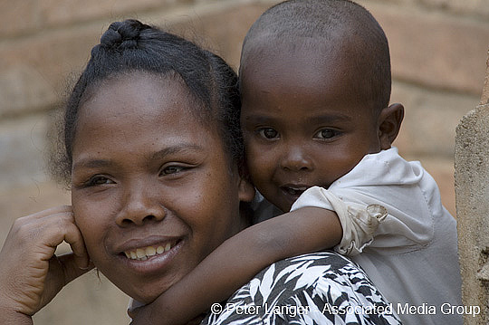
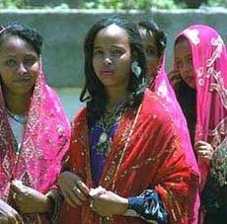
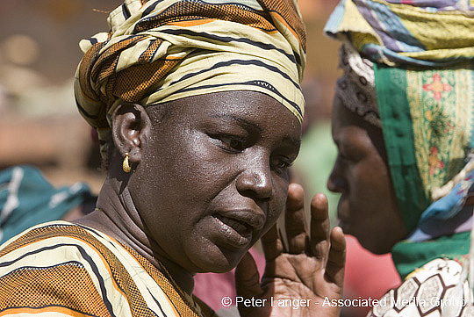
Real Africans…
Notes:
‹#›

Slide 17
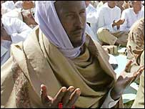
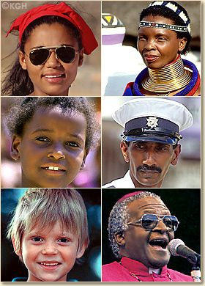
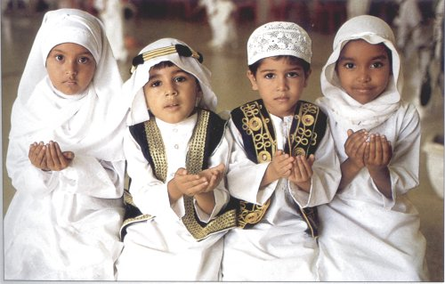
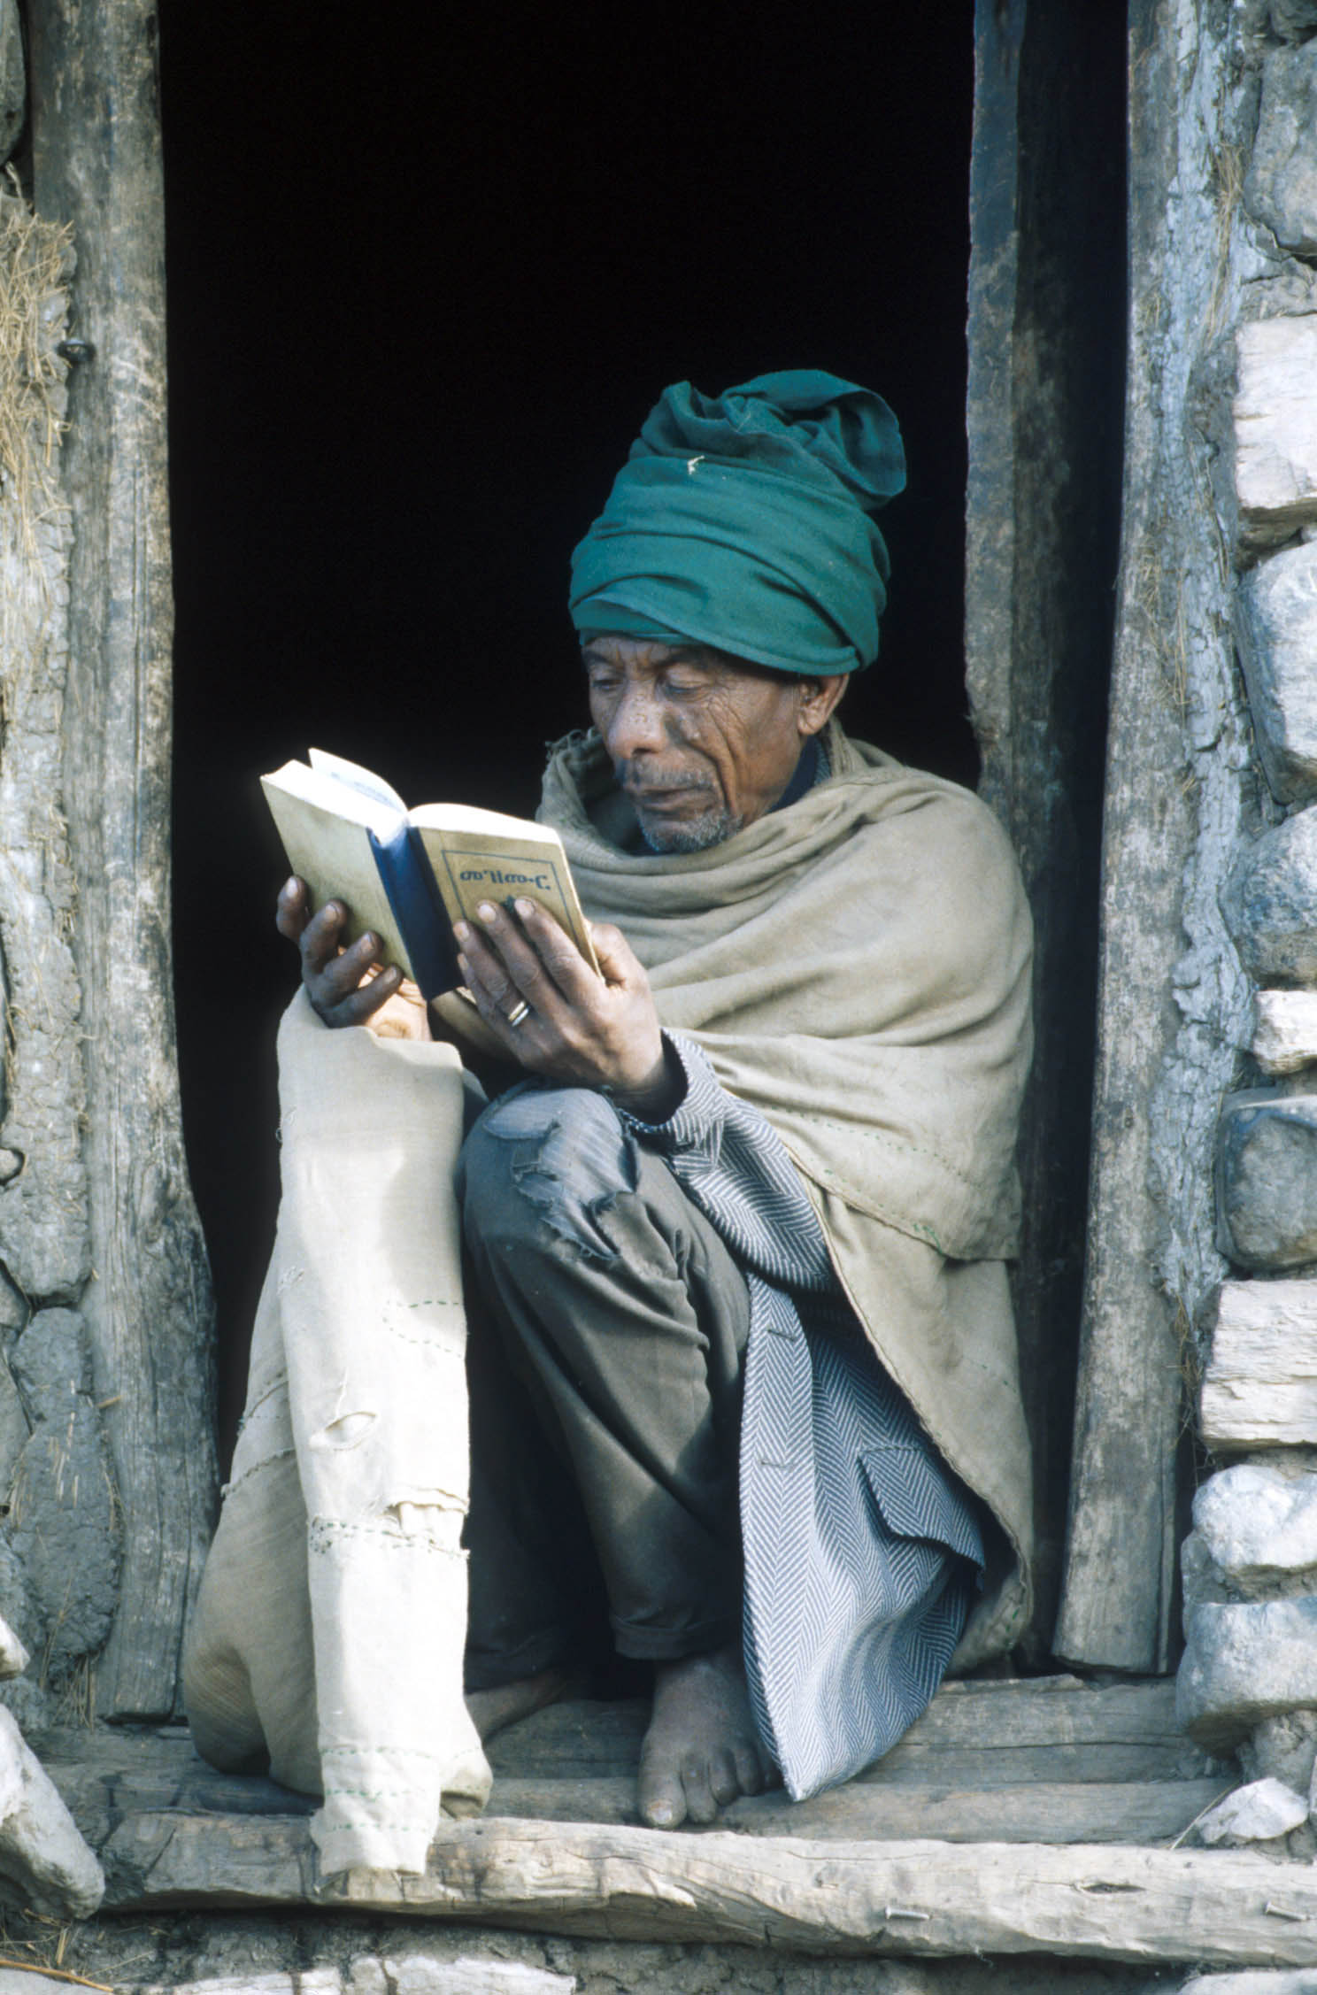
…are of diverse origins, religions, ethnic backgrounds, and ways of life.
There is more diversity in Africa than anywhere else.
Notes:
‹#›

Slide 18
#6 Africa is a country and all the people there speak “African”.
Notes:
‹#›

Slide 19
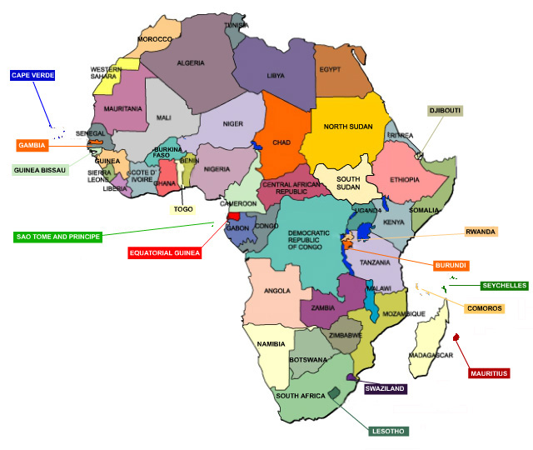
Africa is a continent which has 54 independent states.
Notes:
‹#›

Slide 20
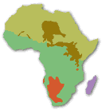
There are between 2000 and 3000 languages spoken on the African continent, with about 8000 different dialects. African languages are categorized into 4 language families. Arabic is also common.
This map shows the four main African language families. © Mark Dingemanse of vormdicht).
• Afro-Asiatic • Nilo-Saharan • Niger-Kordofanian • Khoi-San • Austronesian
Notes:
‹#›

Slide 21
#7 The African continent is mostly “jungle” and tropical rainforest with a few deserts and overpopulation everywhere.
Notes:
‹#›

Slide 22
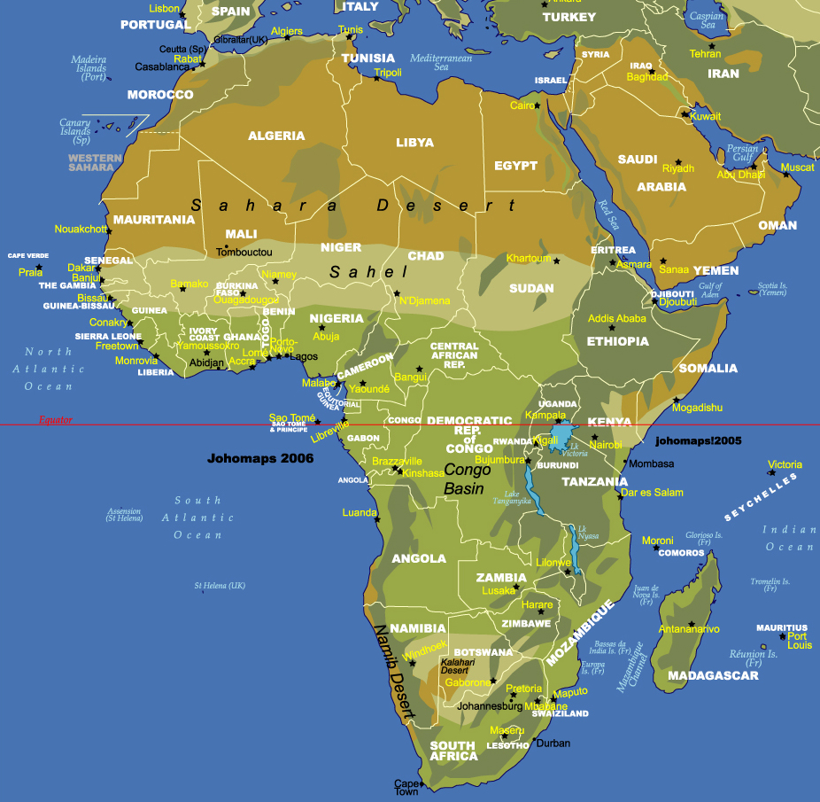
The terrain of the African continent is varied, with mountains, valleys, rivers and lakes, plateaus and savannahs (or grasslands). The climate is varied as well. There is a rainy season and a dry season, humid and dry regions…
Notes:
‹#›

Slide 23
#8 North Africa is part of the Middle East, and not part of Africa.
Notes:
‹#›

Slide 24
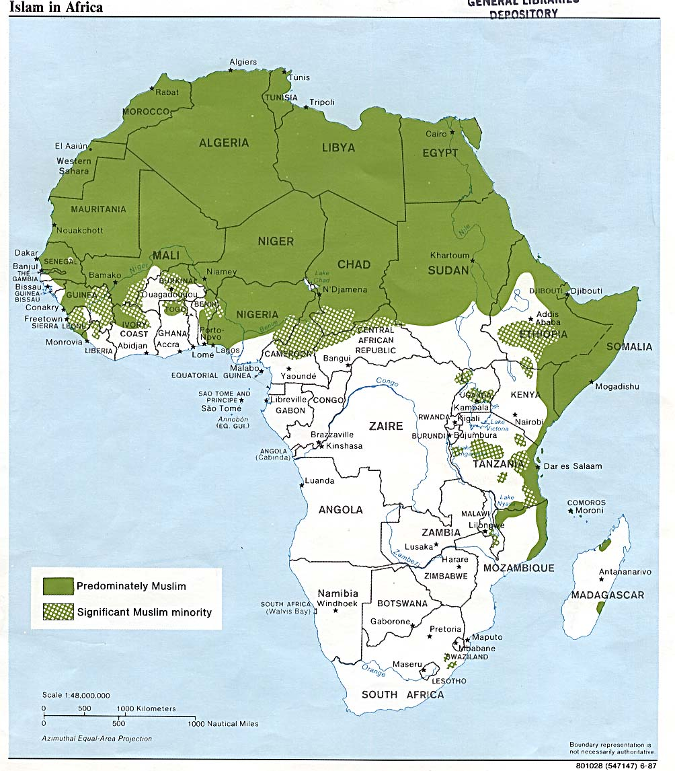
Often people want to consider the northern part of Africa as part of the Middle East because of the influence of Islam. But, if we only consider religion, a much larger portion of the continent would be considered predominantly Muslim; and this percentage is growing.
Notes:
‹#›

Slide 25
#9 Africans are not capable of solving their problems on their own.
Notes:
‹#›

Slide 26
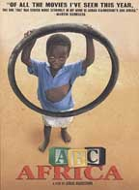
More and more often, African NGOs and grassroots organizations are getting involved in sustainable development projects in their own countries.
In the film, « ABC Africa », we will see one case where a group of women started a project to support and care for AIDS orphans in their community.
Notes:
‹#›

Slide 27
#10 Africa is a continent of misery and problems.
It’s true that there are many problems and challenges facing a number of African countries, however, there are also signs of hope…
Notes:
‹#›

Slide 28
Poverty
19% of Sub-Saharan Africa’s population is undernourished, almost double the figure for the rest of the developing world.
But three-fourths of the population is not malnourished.
Notes:
‹#›

Slide 29
Conflict / War
Only 6 countries were engaged in armed conflict in 2004, compared to 14 wars in 1998.
Despite the decrease in conflicts, there are some 13 million internally displaced people, and 3.5 million refugees in Africa.
Notes:
‹#›

Slide 30
Debt
There are 38 heavily indebted poor countries in the world.
Thirty-two of these are in Africa.
Notes:
‹#›

Slide 31
AIDS
35 million people in the world have the AIDS virus…24.7 million of them are in sub-Saharan Africa, including 91% of the world's HIV-positive children
5,500 AIDS deaths a day.
Life expectancy below 40 years in six African countries
Notes:
‹#›

Slide 32
Current Conflicts in Africa
Notes:
‹#›

Slide 33
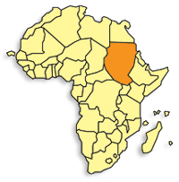
Sudan
Just ended 21-year civil war in 2005
Conflict in Western Darfur region exploded in 2003 and continues today leading to large scale population displacement
South Sudan gained independence June, 2011
Notes:
‹#›

Slide 34
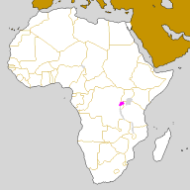
Rwanda
The most densely populated country in Africa: 11.78 million people on 26,338 sq km of land (about the size of Oregon)
During the 1994 genocide:1 million slaughtered over 100 days
Notes:
‹#›

Slide 35
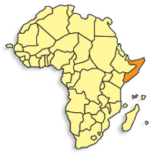
Somalia
Somalia had been without a government from 1991 until August 20, 2012
The years of fighting between rival warlords and an inability to deal with famine and disease have led to the deaths of up to one million people.
Notes:
‹#›

Slide 36
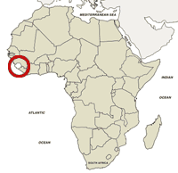
Sierra Leone
11-year civil war in which an estimated 10,000 child soldiers fought
Life expectancy: 34 years in 2005(in U.S. it was 77 years), now it is 58 (U.S. is 79)
Notes:
‹#›

Slide 37
Why do you think these problems are so prevalent in Africa?
Notes:
‹#›

