Slide 1
Why Are Countries Where they Are?
Let’s figure that out

Slide 2
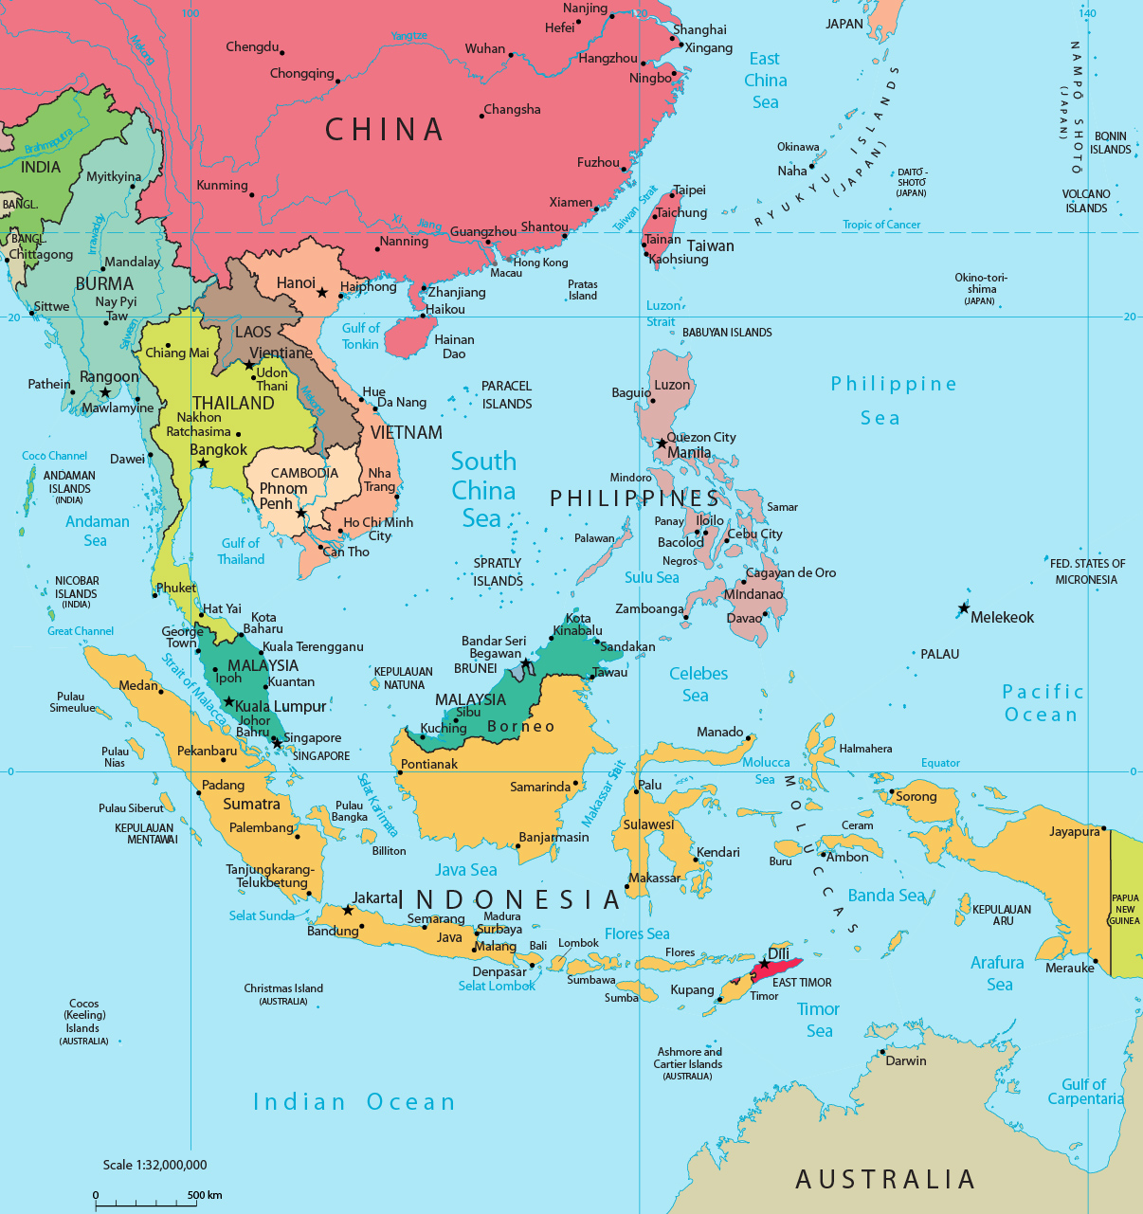
But First, A Priming Question...
What abnormalities have you seen in either naming or location of SE Asian states?

Slide 3
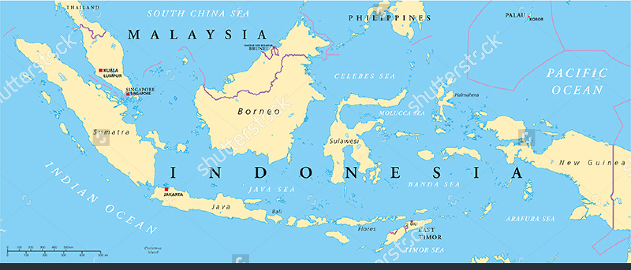
So, Malaysia and Indonesia are in Weird Locations
Yeah, what’s up with that? Where did that come from? Is there a reason?

Slide 4
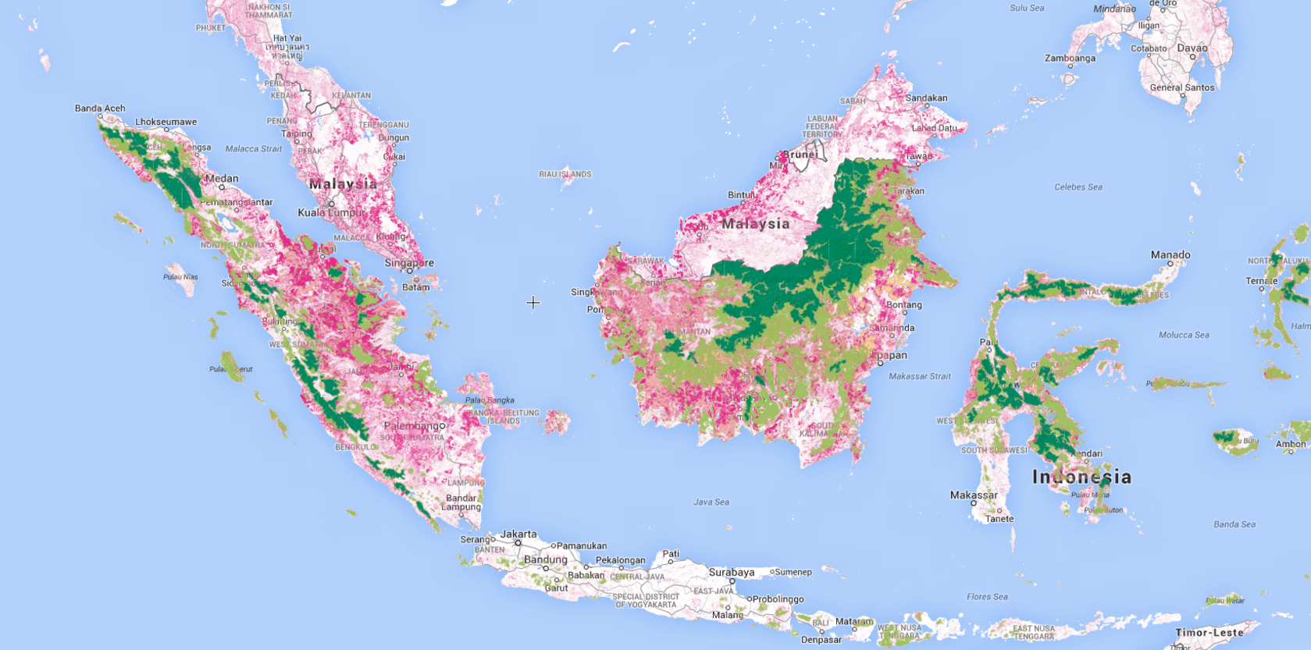
First, a term
Fragmented State – A state that is separated by a physical or human barrier. This creates several problems for the country. It is difficult to govern such a country composed of islands. In addition, communication is difficult within the state; since portions are separated from the main part of the country.
Both Indonesia and Malaysia are fragmented states
Forest loss in Indonesia between 2000 and 2013 (pink), intact forest (dark green) and degraded forest (light green), logged forest (yellow) and oil palm (light pink). (Global Forest Watch)

Slide 5
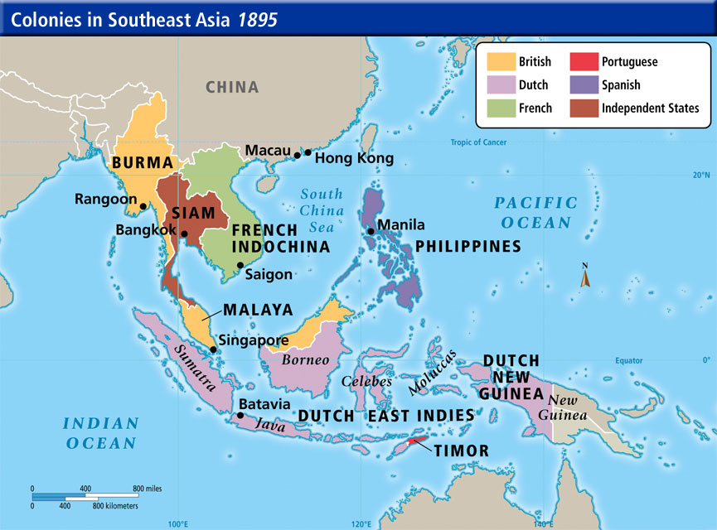
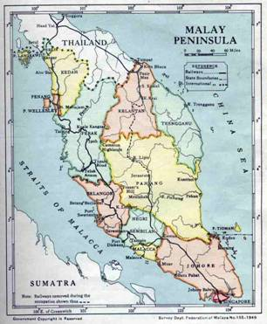
Of Course, Some History
Anglo-Dutch Treaty of 1824 -- Defined claims of Dutch and British claims in SE Asia in wake of Napoleonic Wars
Indonesia declared independence in 1945
British granted independence to Malaysia in 1953. Malaysia incorporates Borneo, Sabah, and Sarawak, modern borders by 1965

Slide 6
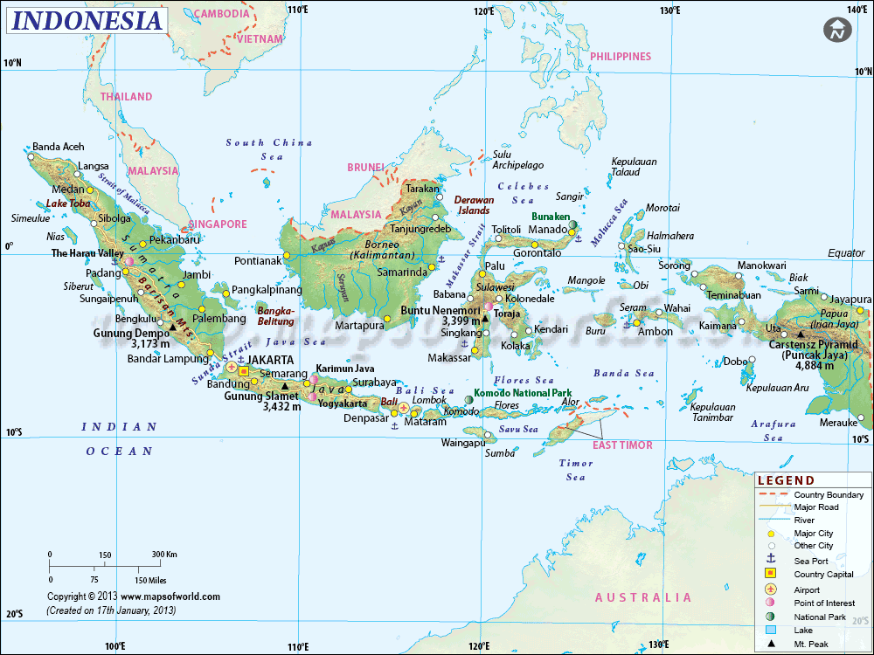
Modern Implications of Colonial Borders
Border disputes common
Why?
Modern borders still not fully agreed upon
Concerns of immigration
Modern borders do not follow ethnic lines
Disputes also over resources
Guess which

Slide 7
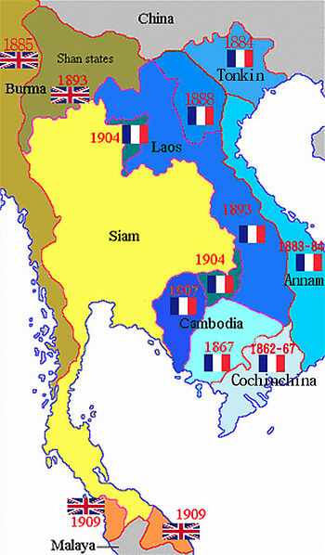
One Vietnam, Two Vietnam,
Red Vietnam, Blue Vietnam
Expansion of French Indochina
France begins colonizing SE Asia in late 19th century after decades of missionizing work
France rules over SE Asia until 1949
Why?

Slide 8
COMMUNISM

Slide 9
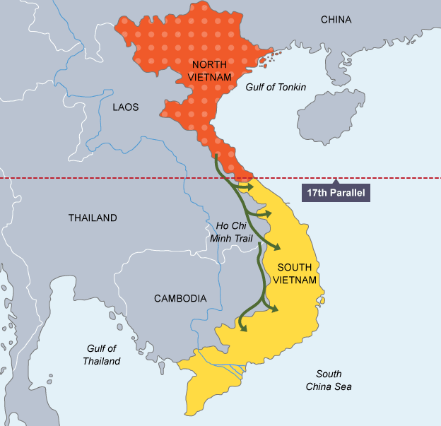
“Postcolonial Vietnam”
US sends “advisers” to Vietnam in 1961 to help fight in civil war
US supports capitalist South Vietnam, ramps up war under LBJ
US withdraws in 1973
Vietnam unifies under Communism in 1975

Slide 10
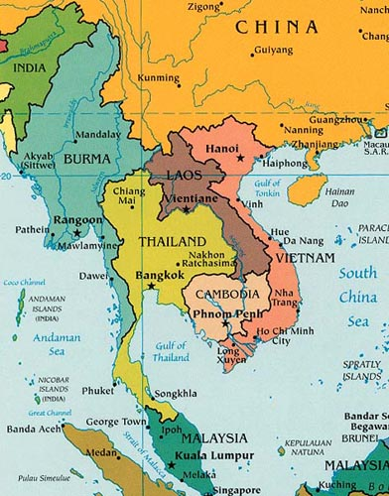
Independent Vietnam
Vietnam unifies under Communism in 1975
Begins slow transition to capitalism/market economy in 1986

Slide 11
Myanmar VS Burma
FIGHT

Slide 12
Insight into Myanmar vs. Burma
https://www.youtube.com/watch?v=8DnluLU73TM
https://www.youtube.com/watch?v=Oub4BbDVFnk

Slide 13
So, which should the US use?

