Slide 1
Advantages/Disadvantages of the North/South During the Civil War
/////\\\\\

Slide 2
Northern Advantages
Better political leader (Lincoln)
More railroads
More industry
More telegraphs
More troops
More people
More ships

Slide 3
Southern Advantages
Fighting for identity
Defensive war
Better military leaders (esp. at start)
Capacity for exports

Slide 4
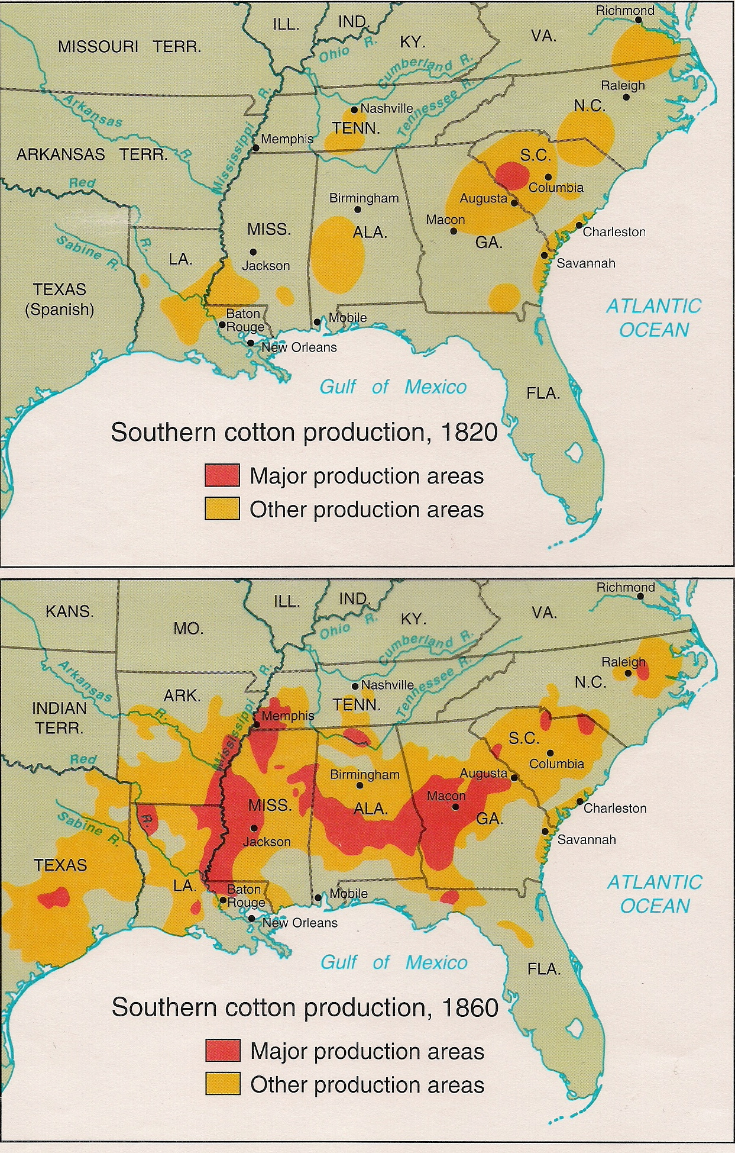

Slide 5
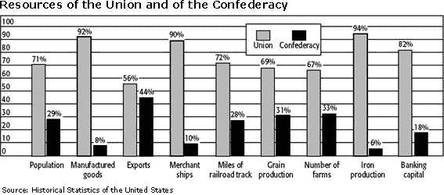

Slide 6
