Slide 1
Mini Lecture on Economy and Resistance in antebellum us

Slide 2
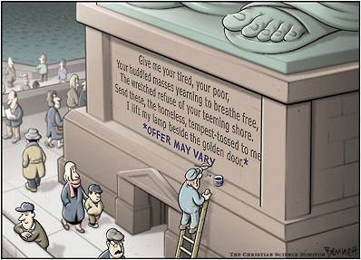
Northern Economy
Industrialized
Wage slavery
Received vast majority of immigrants
More transient population
Railroads made nation “smaller”
Less stratified
Free Labor
Emphasized public education
Hard work = Success
Remind you of anything?

Slide 3
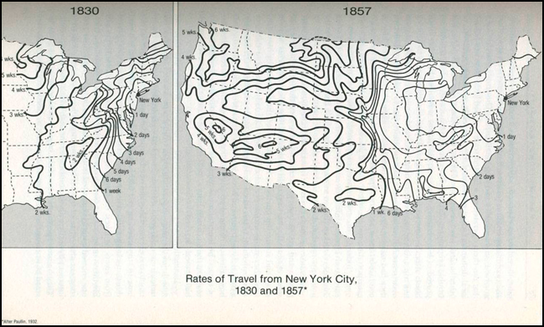

Slide 4
Southern economy
Plantation system
King Cotton rules by 1800 (Cotton Gin)
Necessary to placate poor whites in order to be successful
Highly stratified
ALL wealth at top
Didn’t have debts b/c they didn’t pay employees
Hated by Northerners
Dependent on northern and European factories as purchasers
England less interested in Southern cotton as Indian and Egyptian colonies became more profitable.

Slide 5
Differences btw S chattel slavery and N industrial wage slavery
Chattel Slavery
Rural South
African-Americans
Permeates culture
Overt racism
Intensely personal
“Care” from birth to death
No wages
↓ freedom to improve
Limited movement, rights
Wage Slavery
Urban North
Immigrants and natives
Little personal relationship
Profit - primary purpose
No benefits/protections other than wages
Freedom to move/change jobs (wealth limitation)
Political participation
Impersonal
Racism/discrimination?

Slide 6
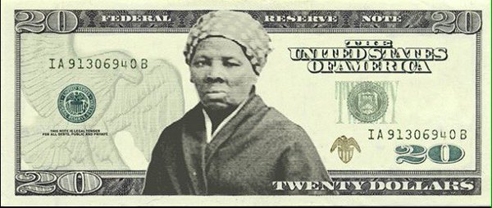
Resistance to slavery
Underground Railroad
Unofficial, illegal network dedicated to getting escaped slaves to freedom
Harriet Tubman ("Moses") (ex-slave who escaped to Canada)
Led 19 expeditions from Canada; rescued 300 slaves including parents
Served Union army in SC as a spy during Civil War

Slide 7
