Slide 1
Opening Act of the Civil War
With a dash of international history

Slide 2
Journal
Do we live in a segregated society today? If yes, in what ways? If no, what progress has been made? Give examples!

Slide 3
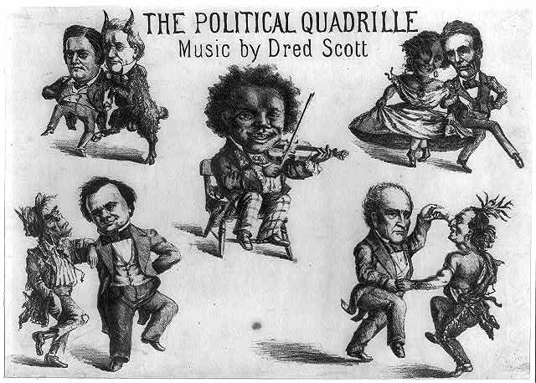
Election of 1860
Democratic Convention
Stephen Douglas (IL) Nominated
Southerners Walk out – Secede from own party
Southern Democrats
John C. Breckenridge (KY) nominated
Urged compromise
Republican Convention
Lincoln (IL) Nominated
Wins Election
Notes:
. In the upper left is Southern Democrat John C. Breckinridge. He is paired with Democratic incumbent and ally James Buchanan, depicted as a goat or (as he was nicknamed) "Buck." At the upper right Republican Abraham Lincoln prances arm-in-arm with a black woman, a pejorative reference to his party's alignment with the abolitionists. At lower right Constitutional Union party candidate John Bell dances with an Indian brave. This pairing is puzzling but may allude to Bell's brief flirtation with Native American interests. (For one instance of the use of the Indian as a nativist symbol see "Know Nothing Soap," no. 1854-3.) At lower left Stephen A. Douglas dances with a ragged Irishman.

Slide 4
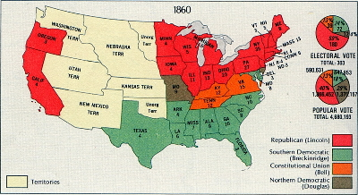
Election of 1860 Results

Slide 5
Southern states secede from Union
December, 1860 - SC unanimously voted to secede
Within six weeks, six other states seceded
MS, FL, AL, GA, LA, TX
Buchanan’s "lame-duck" period
4 others seceded in April, 1861, after beginning of Civil War (VA, AK, NC,TN)
Refused to fight fellow southerners and agree to Lincoln’s call for volunteers
Confederate States of America forms
Jefferson Davis chosen as president of provisional government to be located at Richmond, VA (after Fort Sumter).

Slide 6
President Buchanan (D) Response
Did little to prevent southern secession
Believed Constitution wouldn’t allow it
More significantly, northern army not ready for war
Many of his advisors were pro-South
Northern sentiment favored compromise
Lincoln sought peaceful re-unification
Use of force would likely have driven border states of MD & KY to secede
Probably would have meant end of Union

Slide 7
Civil War begins, 1861
Ft Sumner – April, 1861 (SC)
Union fort in South Carolina
Lincoln sends supplies to feed fort (no troops)
Confederacy sees it as act of war and fires
Ft. Sumner surrenders; Civil War begins
Preparations for a long war relaxed

Slide 8
Battle of Bull Run (Manassas)
First major land battle of the Civil War
By summer 1861, Northern public pressure demanded a quick decisive victory
During battle, Union forces near victory but reinforcements from Shenandoah Valley led by "Stonewall" Jackson surprised fatigued Union forces
Casualties: Union lost 2,896 men; Confederates lost 1,982 - Union Retreat
Psychological impact:
North realized it was in for a long and bloody war
South grew complacent; many deserters--felt war was over
Southern enlistments fell sharply
Preparations for a long war relaxed

Slide 9
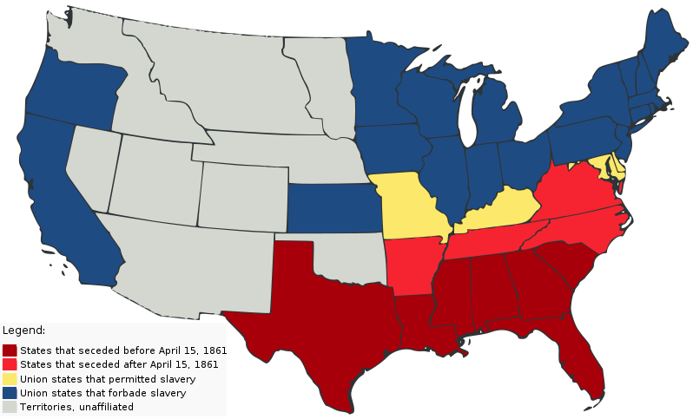

Slide 10
International Civil War
Britain officially neutral
Significant trade with N and S
Did more to help S than N
Cotton and Aristocratic culture
Continued to revile slavery – Uncle Tom’s Cabin
Trent Affair – Reduction of British influence on S
CSS Alabama – Built by British for S
Canada
Generally empathetic to N – Why?
C. War steered Canada from republicanism but influenced confederation

