Slide 1
Antebellum
Culture PT. Two
With a soundtrack by titus Andronicus

Slide 2
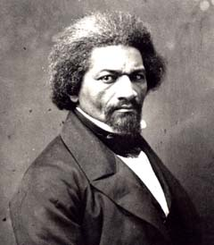
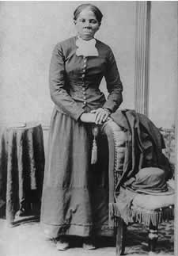
Abolitionism
Philosophy that opposed the existence of slavery
Quakers
Freedpeople
The Liberator and
The North Star
Fiercely resisted
by Northern and
Southern whites

Slide 3
Ken burns – The civil War
Slavery and Abolitionism 9:10 - 22

Slide 4
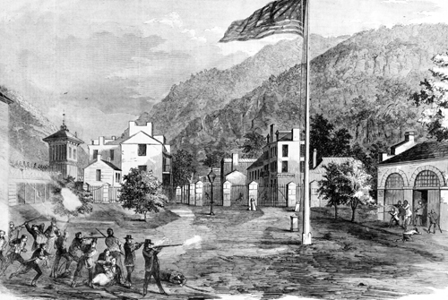
John Brown
Abolitionist
Raid on Harpers Ferry in Virginia (1859)
Wanted to start a violent overthrow of slavery, by slaves
Result: No overthrow of slavery. Solidified North/South political divide. Democrats split their 1860 candidate. Republicans supported Lincoln.

Slide 5
Ken Burns – The Civil War
John Brown 28 - 33

Slide 6
Transcendentalism and Henry David Thoreau
Believed in self-improvement and connection between person and nature
Walden and individualism
Civil Disobedience and Mexican-American War
  “Why are you out there?”
  Why would a transcendentalist oppose the Mexican-American war?

Slide 7
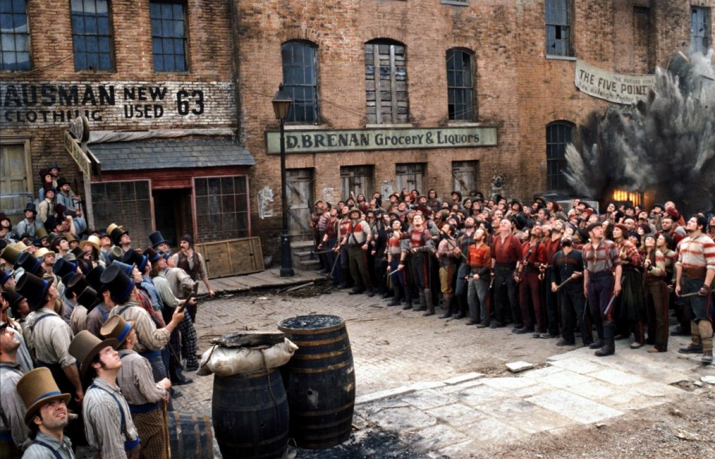
Immigration
Irish
  Poor
  Catholic
  East coast cities
  Escaping
German
  Middle Class
  Rural Midwest
  Protestant
  Pursuing

Slide 9
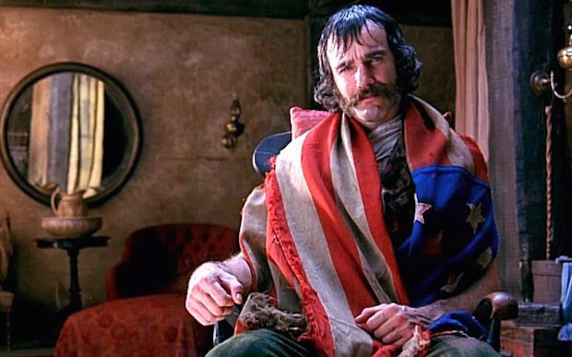
Bill the butcher and the Know Nothings
Nativist
WASP
Anti-Catholic
  Loyalty?
Anti-immigrant
  Restrict right to vote
  To immigrants

Slide 10
Second great awakening
Further democratization of religion
Emphasized stratification/roles in South
  Gender
  Slaves
Church membership doubled between 1800-20
  Mostly in Evangelical/Protestant churches
Wanted to reform society’s morals
  Temperance

Slide 11
Northern racism
Separation
Republicans
  Opposed spread of slavery
    Varying opposition to the spread of black people
Refusal to hire Freedpeople common

Slide 12
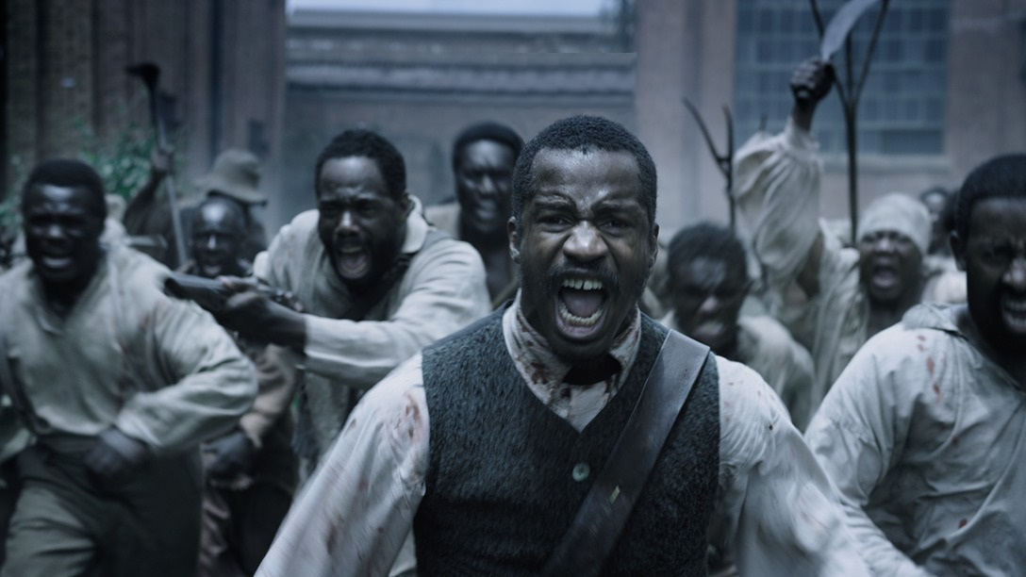
Southern racism
Subjugation
Wanted to spread slavery
  And thus their brand of racism
Abolitionism absent after Nat Turner’s failed rebellion (The Birth of a Nation)

