Slide 1
Origins of Slavery in the Americas

Slide 2
First, some terms
Indentured servant
Laborers who are under a contract to serve their master for a period of time, usually 4 – 7 years. In exchange, they received shelter, food, passage across seas, and accommodations.
Why might someone sell themselves into servitude?
Chattel
A personal possession
Slave
Person sold into servitude
Immigrant
Person who moves to a new country permanently

Slide 3
Why Africans?
Indentured Servants
Expensive
Less sustainable
Often demanded land after servitude, lack of jobs after completion
became less available as English economy improved
Unable to enslave Native Americans
Too few, knew territory, well-established
Easy to steal
Slavery already present in West Africa

Slide 4
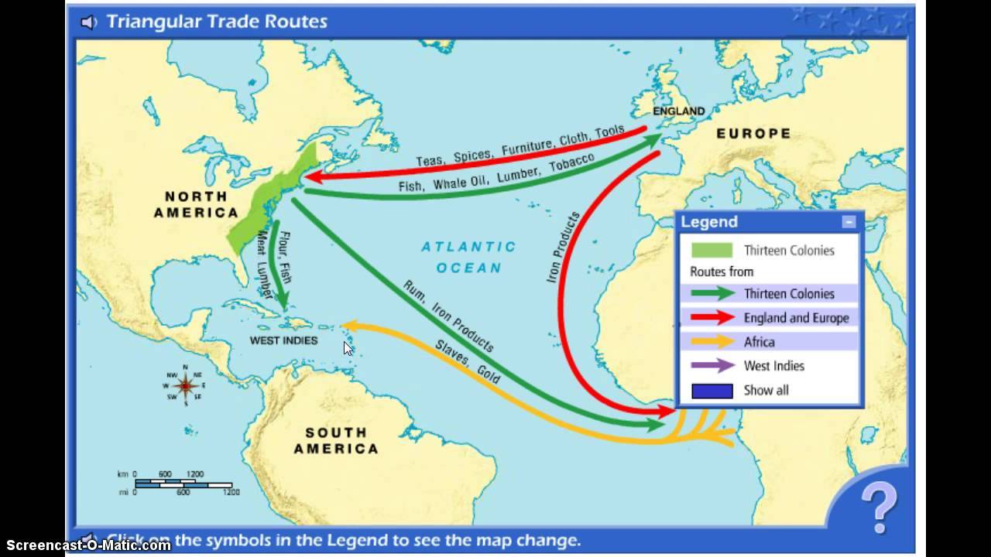

Slide 5
Brazilian Slavery
30-40% of all African slaves
Patriarchal social organization
Fazenda (hacienda) - large estate/plantation
Master and family
Obrigados (sharecroppers)
Agregados (free hired men)
Slaves
Largest slave population in Americas
Multi-racial society
“Passing”
Labor competition - poor whites & mulattoes

Slide 6
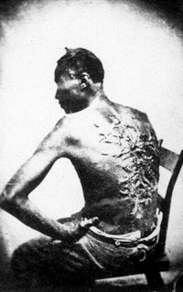
Brazilian Slavery cont.
Cheaper to buy new slaves than raise from birth to death
Leads to increased brutality in slave system
Faster shipping to SA & West Indies
Shorter “Middle Passage”
Death rates 50% less (1/6 vs 1/3)

Slide 7
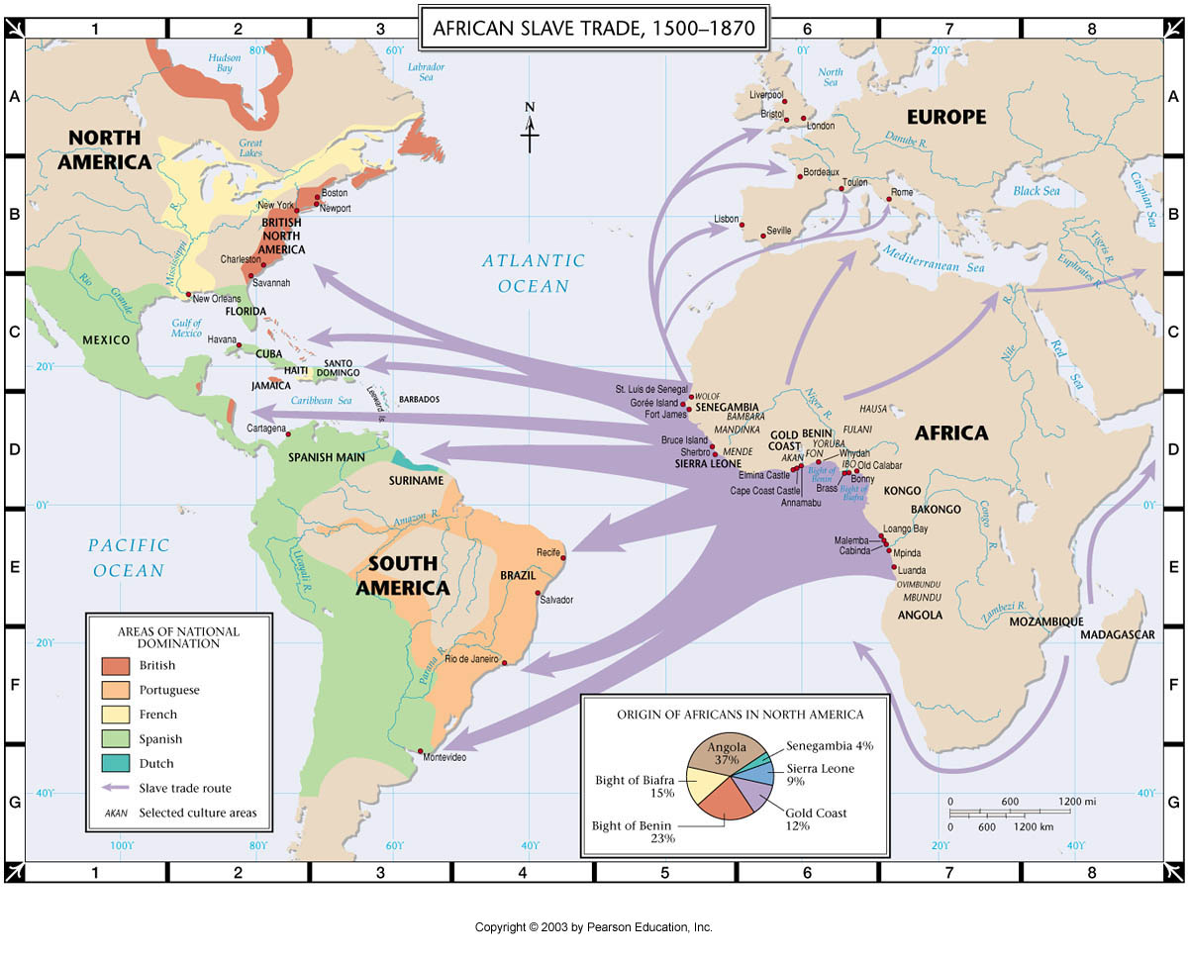

Slide 8
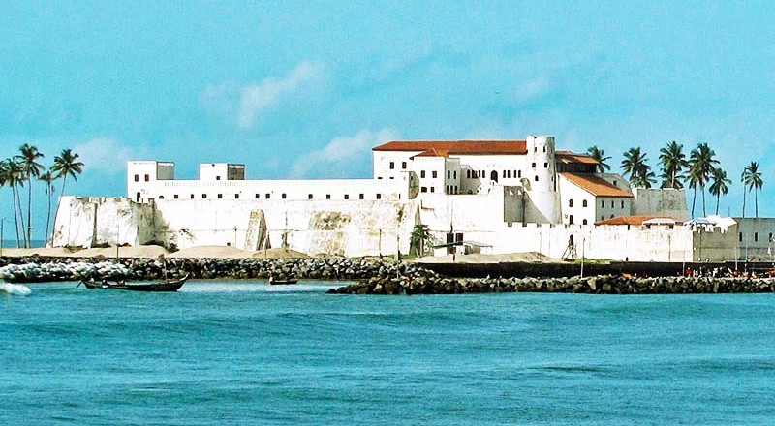

Slide 9
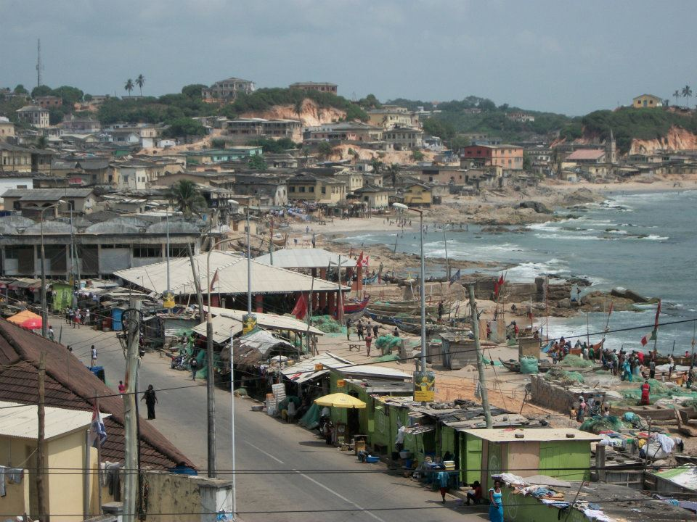

Slide 10
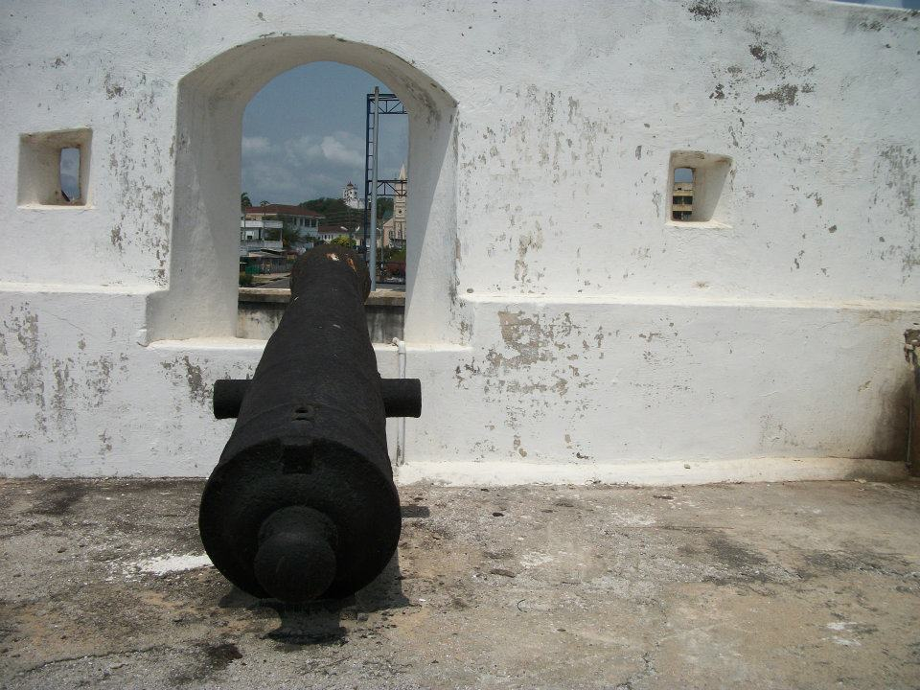

Slide 11
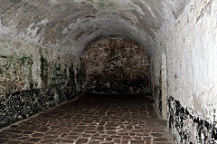

Slide 12
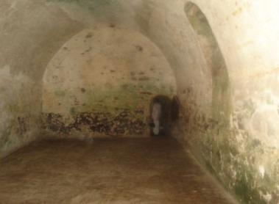

Slide 14
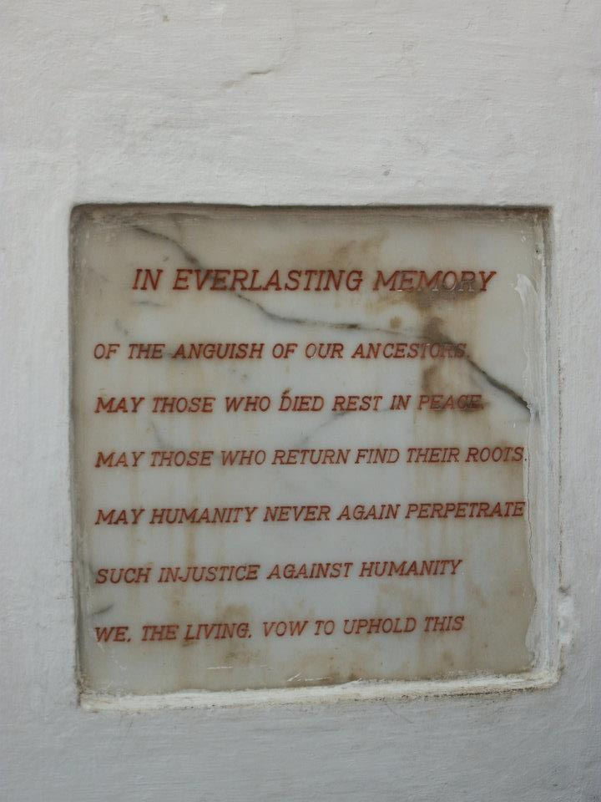
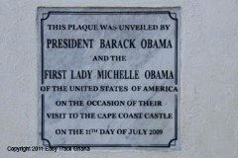

Slide 16
Black Codes in US
Based on practices/laws in Barbados (West Indies)
Why would courts need legal definitions for slaves?
Defined condition of Chattel Slavery
Owners must provide clothing, food, shelter
No guns to slaves
Taught Christianity, but banned reading
Christian Conversion did not end slave status
Indemnified owner for damage/death of slaves
Virginia, 1705 -- "If any slave resist his master...correcting such slave, and shall happen to be killed in such correction...the master shall be free of all punishment...as if such accident never happened."
Permanent, inheritable (hereditary) servitude

Slide 17
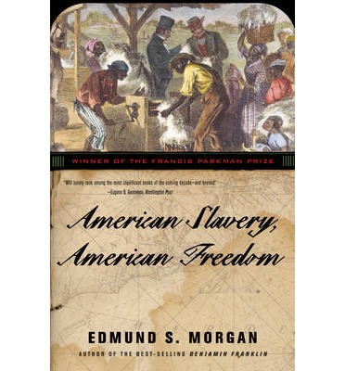
Independence? Slaves?
“If you put a chain around the neck of a slave, the other end fastens around your own.”
Ralph Waldo Emerson 1842
Respond.

Slide 18
Slavery? Freedom?
Slavery and the concept of American Independence evolved alongside each other
As slaves became cheaper (i.e. living conditions improved in VA), demand increased
Racism invented to prevent sympathy between poor whites and slaves
Slaves socially marginalized
Outlawed miscegenation, emancipation

Slide 19
Rise of US Slavery
Colonies coping with labor shortage in late 17th century
Discontent among indentured servants
Solution of slavery is gradually introduced
Half of labor force is enslaved by 1700
Much more so within a decade
Problems with freedmen persists due to lack of opportunity

Slide 20
The Invention of Racism
Discipline required to keep slaves working
Methods and justification linked to racial contempt
“Uncivil, Unchristian, Unwhite”
Politicians convince poor whites they have similar interests
Crops

