Slide 1
Longitude, Latitude and Climate

Slide 2
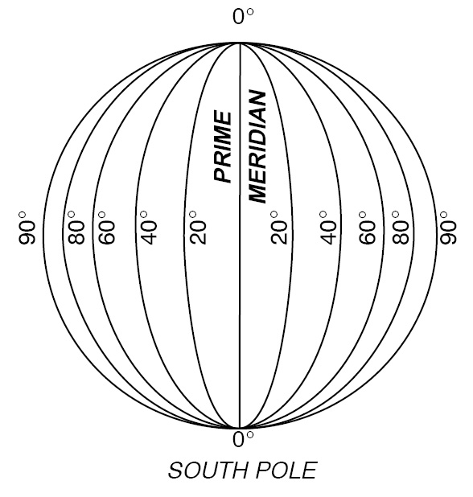
Longitude
Lines running north to south that measure east to west.
0° = Prime Meridian
180° = International Date line
Point at which day changes

Slide 3
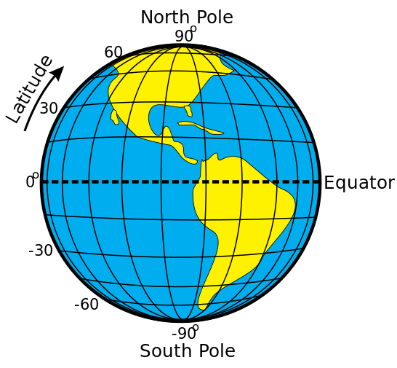
Latitude
Parallel lines that run east to west and measure north to south.
0° = Equator
23.5° N = Tropic of Cancer
23.5° S = Tropic of Capricorn

Slide 4
Climate and Latitude
Areas with similar latitudes share:
Same:
Day length
Seasons
Consequences
Easier to transplant plants and animals between areas of similar latitudes

