Slide 1
We Hold These Truths…

Slide 2
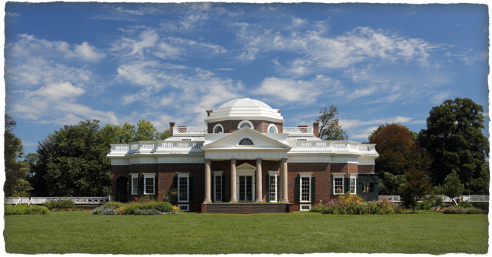
Inspiration
Wrote alone, with no books directly at his side

Slide 3
Inspiration
Declaration of the Rights of Man
Locke
Life, liberty, propertyWhat are the main differences between fighting for “Life, liberty, and property,” and “Life, Liberty, and the pursuit of happiness”?

Slide 4
Inspiration
Scottish Enlightenment
Jefferson educated by a Scot
Consent of the governed
Right of people to take over government

