Slide 1
Five Map Elements
For when you want to map your room

Slide 2
Title
Title of the map. Usually describes what is in the map itself.
“Political US Map”
“Climates of East Asia”
“Grocery stores in Eugene”

Slide 3
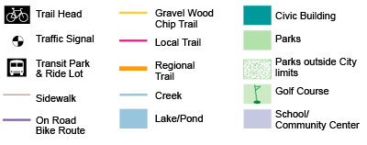
Legend/Key
The legend of a map (also called the key) is a small table accompanying the map that explains the symbols that are used on the map.
What in your room might be represented in the legend? What symbols would represent them?

Slide 4
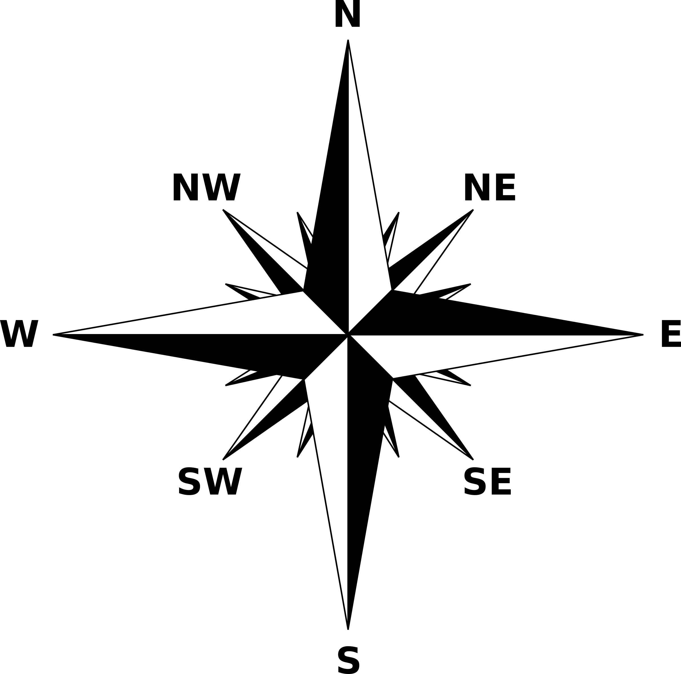
Compass Rose
A design on a map that shows direction. It points which way is north, south, east, west, and some intermediate directions on the map.
Do you know which way is north in your room? How about right now?

Slide 5
Scale
The ratio of the distance between two points found on the map as compared to the actual distance between these points in the real world.
What might be the scale for your bedroom? The city of Eugene? The United States?

Slide 6
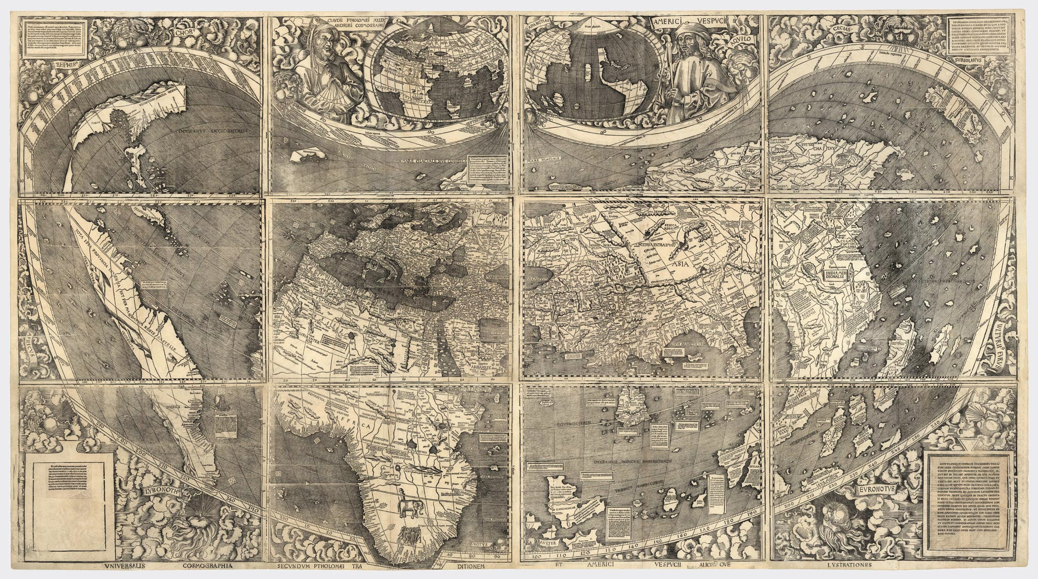
Cartographer
The person who made the map.
Can you name any famous cartographers?

Slide 7
The END!

